Slide 1
Campaign finance Reporting
Montana Commissioner of Political Practices
cpphelp@mt.gov / @MontanaCOPP

Slide 2
File the statement of candidate within 5 days!
candidates must file a Statement of Candidate with the copp within 5 days of becoming a candidate, 13-37-201(2)(a), MCA
An individual becomes a candidate when they receive or solicit a campaign contribution, make a campaign expenditure, or file as a candidate with the election administrator, whichever comes first
The statement of candidate must be filed electronically, using CERS

Slide 3
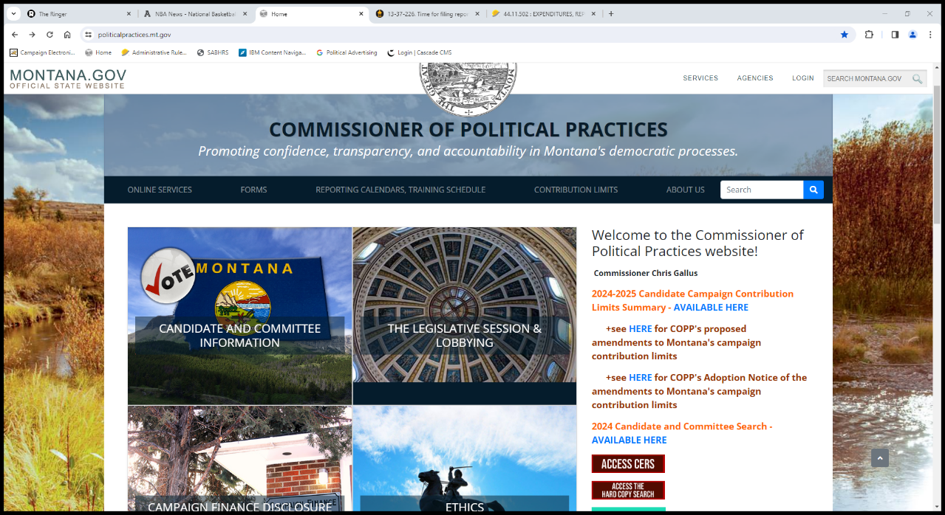
Step 1: Access CERS

Slide 4
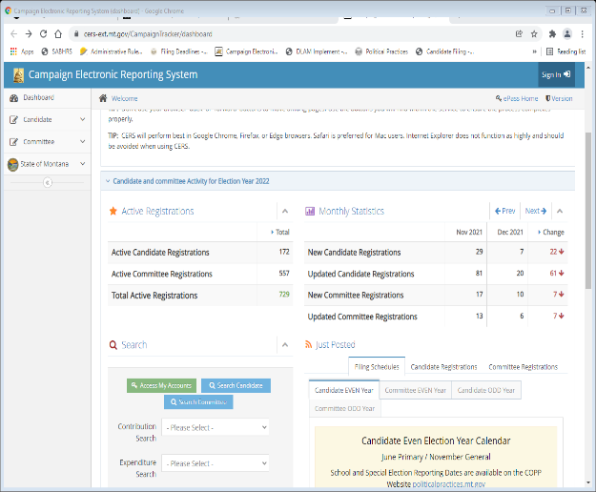
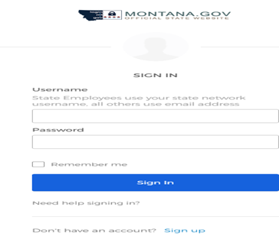
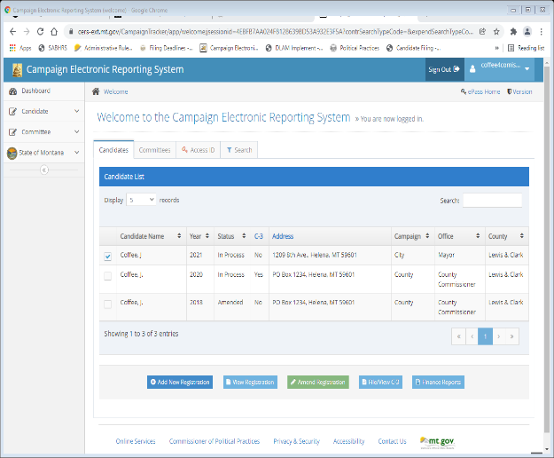
Accessing cers- steps
1. Access my accounts
2. Login using OKTA
3. ADD NEW REGISTRATION

Slide 5
Statement of candidate- requirements
The statement of candidate must include:
The full name, complete mailing address, email address, and office sought for the candidate;
The full name, complete mailing address, and email address for the campaign treasurer (candidate can serve as own treasurer); and
The name and address for the campaign depository (bank)

Slide 6
Statement of candidate- reporting status
‘b’ box: combined contributions/expenditures under $500
‘b’ box candidates not required to file finance reports
Must begin filing finance reports if contribution/expenditure activity hits $500
‘c’ box: combined contributions/expenditures meet or exceed $500
‘c’ box candidates are required to file finance reports disclosing contributions received and expenditures made

Slide 7
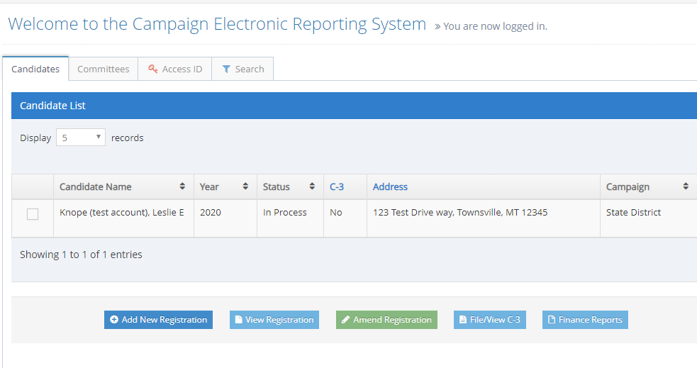
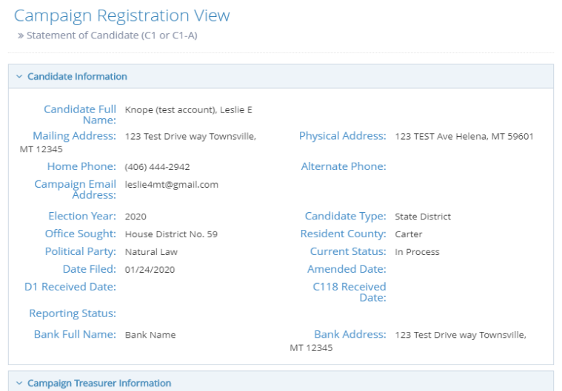
Update your statement of candidate Within 5 days of change!
Treasurer revision, email or phone number change, etc.
Notes:
If you have changes in your candidacy, from a new email to new treasurer, you must update your statement of candidacy file an amended C1/C1A – Local candidates (C1A) if you filed as a ‘B’ box candidate and you received or spent more than $500, you must amend your C1A to ‘C’ box status and file campaign finance reports per reporting schedule

Slide 8
Reporting dates
Even Years – Statewide, State District & County candidates
Note - School District & City (Odd years) candidates have different calendars – see reporting calendar tab on website
C-5 campaign finance reports are due march 20, April 20, may 20, June 20, august 20, September 20, October 20, and November 20
Full reporting calendar available on the reporting calendars section of copp website

Slide 9
Campaign contribution limits
Candidates limited in amount they can accept from contributors
In-kind contributions count towards the contribution limits
A Candidate is not limited in what they can contribute to their own campaign
https://politicalpractices.mt.gov/Home/Contribution-Limits
Notes:
Campaign finance limits apply to each election; local elections Independent – no aggregate, just per election;

Slide 10
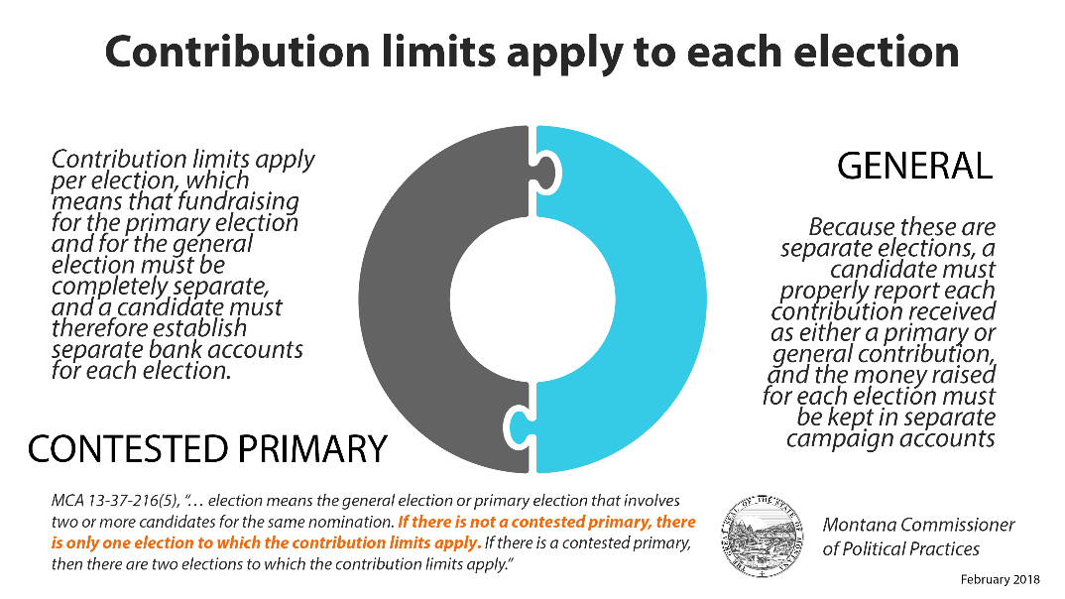
Contribution Limits apply per election!
"election" means the general election or a primary election that involves two or more candidates for the same nomination
If you participate in a contested primary, then there are two elections to which the contribution limits could apply- primary and general
If you do not participate in a contested primary, there is only one election to which the contribution limits apply- general
Notes:
1 report, 2 accounts. Deposit general contributions in separate account, report contribution as primary or general in your finance report.

Slide 11
Campaign account
Candidates “shall designate one primary campaign depository for the purpose of depositing all contributions received and disbursing all expenditures made”, 13-37-205(1), MCA
Can have a primary and general election account
Best practice is to run all campaign activity directly through the campaign bank account!
If self-funding your own campaign, deposit funds in a dedicated campaign bank account
Acquire a debit or credit card tied to the campaign bank account to use for all expenditures
exclusive use of the campaign bank account for campaign activity is easiest way to track OF all CAMPAIGN TRANSACTIONS
This Photo by Unknown author is licensed under CC BY-SA.

Slide 12
Reporting contributions- primary and general
Legislative candidates: if participating in a contested primary, primary and general election contributions may be deposited into the same account if:
The candidate maintains records concerning whether contributions were designated for the primary or general election, and
The balance in the account does not drop below the amount of general election contributions received until after the primary election
If not participating in a contested primary, all contributions in one account

Slide 13
Reporting contributions- primary and general
all other candidates: If participating in a contested primary, Primary and general election contributions need to be separated
Primary election contributions in primary election account
general election contributions in general election account
If not participating in a contested primary, all contributions in one account

Slide 14
File your report electronically, using cers
All c-5 campaign finance reports must be filed electronically, using the campaign electronic reporting system (cers)
Access Cers from the copp’s website, https://politicalpractices.mt.gov/
click the ‘access cers’ icon

Slide 15
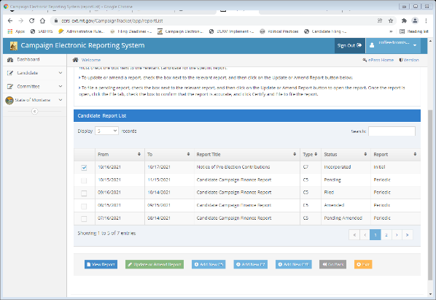
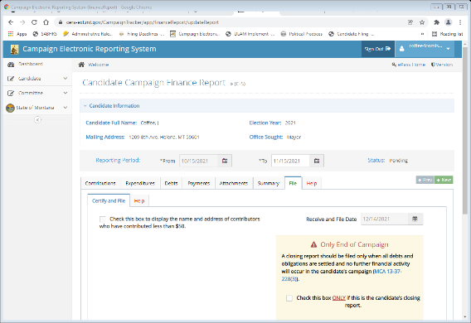
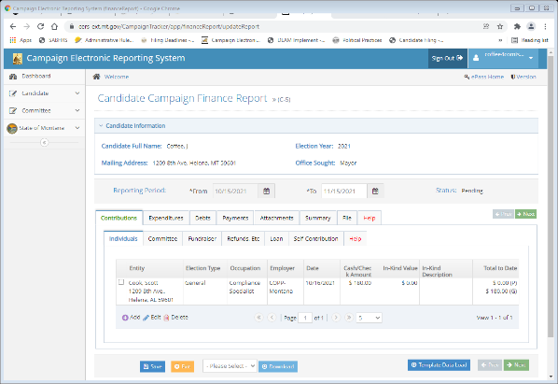
Filing a C-5 campaign finance report
Step 1
Step 2
Step 3
Access the C-5 report
Report contributions received, expenditures made, debts owed, and payments
Certify and file the report

Slide 16
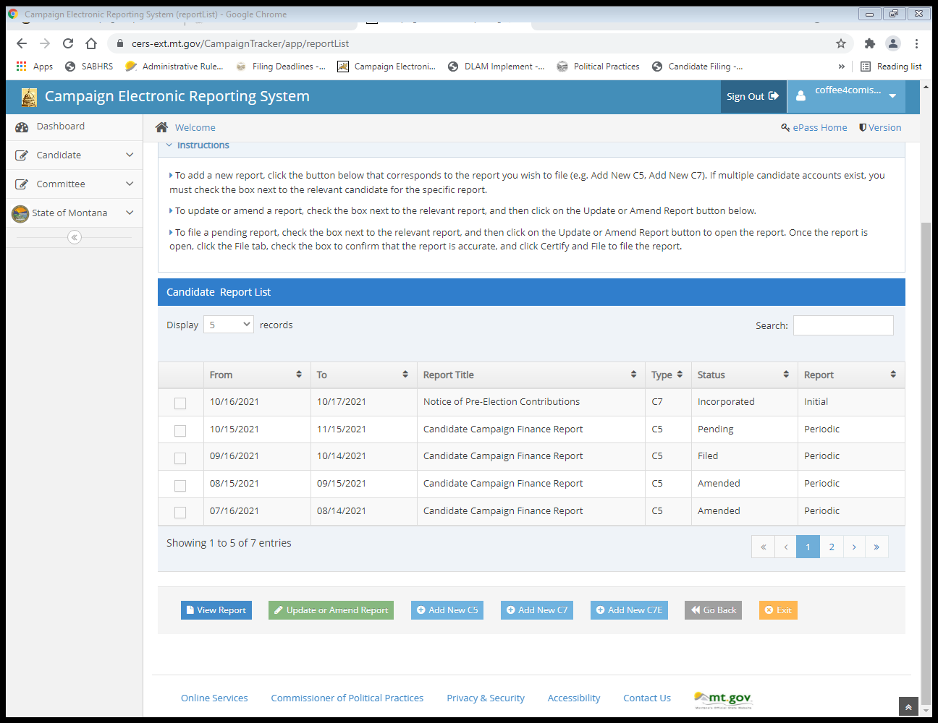
Step 1: Access the c-5 report
Navigate to the candidate report list
Select ‘add new C5’ to begin a new c-5 campaign finance report; select ‘Update or Amend Report’ to update or amend an existing report
Best practice is to update the report regularly as contributions are received and expenditures made
Data is not public IF "saved" and "PENDING"
A REPORT IS NOT actually filed until the candidate "certifies AND files" THE REPORT
Notes:
Follow reporting calendar; amend and save as you go, do not ‘FILE’ until end of reporting period.

Slide 17
Access the C-5 report
Check the reporting period on your C-5 report! Campaign activity outside this window WILL cause AN error CODE to be generated
From= Beginning date for the reporting period (this is automatically filled in by the system based on the end date of your LAST FILED REport)
To= end date for the reporting period
Reporting periods for each report are included on the Copp’s reporting calendars page

Slide 18
Step 2: report contributions received, expenditures made, debts owed, and payments
This Photo by Unknown author is licensed under CC BY-SA.

Slide 19
Reporting contributions received
Anonymous contributions not allowed!!
Report all contributions received using the ‘contributions’ tab
Six types of contributors:
INDIVIDUALs
COMMITTEEs
FUNDRAISERs
REFUNDS, ETC.
LOANS
CANDIDATE CONTRIBUTIONS

Slide 20
Reporting contributions received
Monetary contributions:
Cash/check FOR DEPOSIT
In-kind contributions:
Items or services of value provided to the campaign
Not cash/check deposited

Slide 21
Adding individual contributions
Individual contribution= contribution received from an individual other than the candidate
Under Contributions tab, navigate to the ‘individuals’ subtab
Click ‘add’ to add a new individual contribution

Slide 22
Adding individual contributions
Use ‘Row Details’ to manually enter
‘entity search’ allows you to search for contributor
When all information has been entered, hit ‘submit’
Save after every entry!

Slide 23
Adding individual contributions
Reminder- anonymous contributions are prohibited!
All contributors whose aggregate (total) contributions are $50 or more must be reported with the contributor’s full name, address, occupation, and employer
Occupation- be specific! For example: ‘financial consultant’ or ‘it consultant’ instead of just ‘consultant’
Employer- include the full name of the business/entity that employs the contributor
"Business Owners" must include ANME of the Business and/or TYPE of occupation in addition to "Business OWneR"

Slide 24
Adding individual contributions
For contributions received via an online platform (Actblue, win red, paypal, etc.), report the full amount of the contribution provided by contributor
Report using the name of the original contributor, not the online platform
Any processing fee paid by the contributor must be reported as an in-kind contribution received

Slide 25
Adding committee contributions
Committee contribution= contribution received from a political committee
Under Contributions tab, navigate to the ‘committee’ subtab
Click ‘add’ to add a new committee contribution

Slide 26
Adding committee contributions
Use ‘Row Details’ to manually enter
‘entity search’ allows you to search for contributor
When all information has been entered, hit ‘submit’
Save after every entry!

Slide 27
Adding committee contributions
Committee types: ballot issue, incidental, independent (PAC), political party
Aggregate limit for political party committee contributions
This Photo by Unknown author is licensed under CC BY.

Slide 28
Adding fundraiser contributions
Fundraiser contribution= aggregate contributions under $50 received at a mass collection event
Under Contributions tab, navigate to the ‘fundraiser’ subtab
Click ‘add’ to add a new fundraiser contribution

Slide 29
Adding fundraiser contributions
Use ‘Row Details’ to manually enter
When all information has been entered, hit ‘submit’
Save after every entry!

Slide 30
Adding fundraiser contributions
The fundraiser subtab is meant only for contributions of less than $50.00 received at a single mass collection event
Examples: a pass the hat gathering, campaign raffle, or silent auction event
ANY contribution of $50.00 or must be reported using the ‘individuals’ tab, even if the contribution is received at a mass collection event
See COPP guidance about reporting contributions received at fundraiser events
This Photo by Unknown Author is licensed under CC BY-NC

Slide 31
Adding fundraiser contributions
Report each individual mass collection event separately
When reporting a fundraiser, the date of the event, the location of the event, and the number of attendees/tickets sold must be included
Campaign must know name of any contributor- anonymous contributions not allowed!

Slide 32
Refunds, etc.
Refunds, etc.= refunds, rebates, or other indirect contributions received by the campaign
Under Contributions tab, navigate to the ‘refunds, etc.’ subtab
Click ‘add’ to add a new Refund, etc.
Save after every entry!

Slide 33
Refunds, etc.
Use ‘Row Details’ to manually enter
‘entity search’ allows you to search for contributor
When all information has been entered, hit ‘submit’
Save after every entry!

Slide 34
Refunds, etc.
The “Refunds, etc.” tab is used only to report refunds, rebates, or other indirect contributions received by the campaign. Examples include:
Interest earned from the campaign bank account
rebates given to a campaign by a vendor for previous purchases
refunds provided to a campaign by a vendor for services the campaign has already paid for

Slide 35
Candidate contribution vs. candidate loan
Candidate contribution
Report using the ‘self-contribution’ subtab
Campaign cannot reimburse or otherwise pay back self-contributions at any time
Candidate loan
Report using the ‘loans’ subtab
Campaign can reimburse or otherwise pay back
Does not need to be paid back in full- candidate can forgive an outstanding balance

Slide 36
Adding a loan
loan= contribution the campaign is obligated to pay back
Under Contributions tab, navigate to the ‘loans’ subtab
Click ‘add’ to add a new loan

Slide 37
Adding a loan
Use ‘Row Details’ to manually enter
‘entity search’ allows you to search for contributor
If candidate loan, simply click the ‘click here to add candidate loan’ icon
When all information has been entered, hit ‘submit’
Save after every entry!

Slide 38
By definition, any loan to a campaign is a contribution- 44.11.405, ARM
contribution limits apply to campaign loans
Any loan (regardless of amount) made to the campaign during a reporting period is reported using the “Loans” tab. This includes personal loans made by a candidate to their campaign
ADDING A

Slide 39
Adding a candidate contribution
Candidate contribution= contribution made by the candidate to own campaign
Under Contributions tab, navigate to the ‘Self-Contribution’ subtab
Click ‘add’ to add a new candidate contribution

Slide 40
Adding a candidate contribution
CERS Automatically recognizes the candidate as the contributing entity
When all information has been entered, hit ‘submit’
Save after every entry!

Slide 41
REVIEW
Let’s Navigate on CERS - real time Examples
Questions from participants
Notes:
REVIEW CONTRIBUTIONS online real time on CERS

Slide 42
Expenditure= a purchase or payment made by a candidate using campaign funds
Examples: campaign fliers; radio advertisements; television commercials
REPORT each expenditure USING THE “expenditures” tab
EXPENDITURES

Slide 43
Adding an expenditure
Under expenditures tab, navigate to the ‘expenditures’ subtab
Click ‘add’ to add a new expenditure

Slide 44
Adding an expenditure
Use ‘Row Details’ to manually enter
‘entity search’ allows you to search for entity
When all required information has been entered, hit ‘submit’
Save after every entry!

Slide 45
Expenditures must be included on the finance report covering the period where the expenditure was made
Expenditures must be supported by a “written agreement, invoice, billing statement, or similar documentation appropriate to the transaction”, 44.11.502, ARM

Slide 46
All expenditures must be reported with:
1) full name and address of the vendor
2) the date of the expenditure
3) the purpose of the expenditure
4) the full amount of the expenditure

Slide 47
“Reports of expenditures made to a consultant, advertising agency, polling firm, or other person that performs services for or on behalf of a candidate, political committee, or joint fundraising committee must be itemized and described in sufficient detail to disclose the specific services performed by the entity to which payment or reimbursement was made”, 13-37-229(2)(b), MCA

Slide 48
online contribution processing fees
For contributions received via an online platform (Actblue, win red, paypal etc.), report processing fee/s charged by the platform as an expenditure of the campaign
The online donor platform would be listed as the entity
All processing fees paid during the reporting period can be aggregated and reported as one expenditure

Slide 49
Social Media Expenditure Reporting
As with any other expenditure, report all paid social media activities
If contracted out or part of an ad Agency service, must be itemized
Notes:
In describing a paid social media expenditure, you may use date range

Slide 50
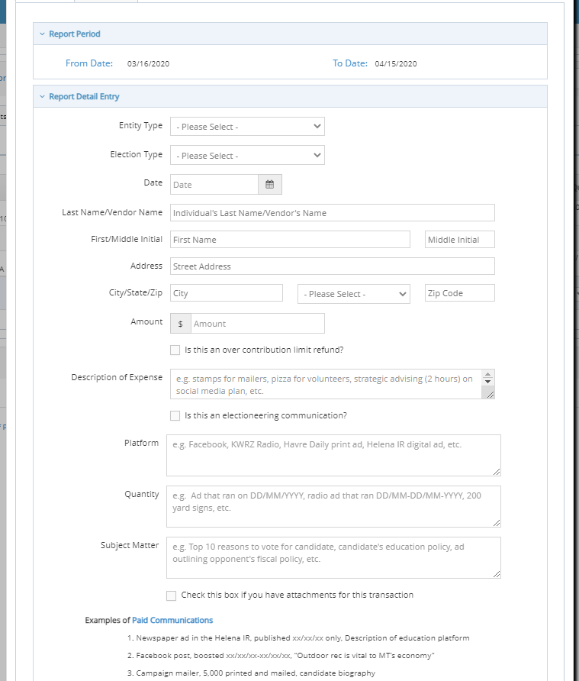
Add an attachment
Can add a receipt, statement, or invoice as an attachment when reporting an expenditure
Notes:
Treat paid social media ads, boosts, promotions, sponsored, etc. as any other expenditure – Detail and describe expenditure in the ‘Purpose’ field

Slide 51
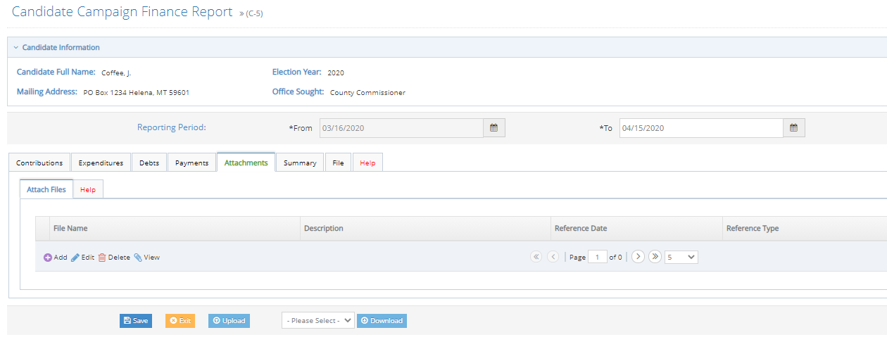
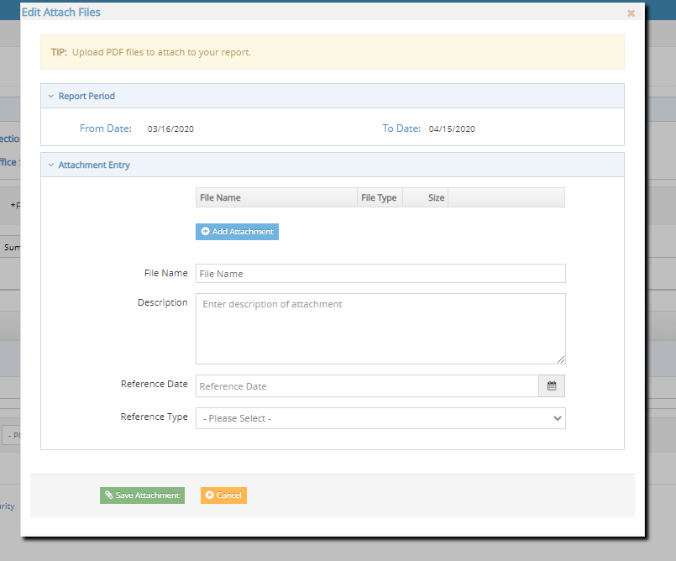
Add an attachment
To add an attachment, use the ‘attachments’ tab
Notes:
Treat paid social media ads, boosts, promotions, sponsored, etc. as any other expenditure – Detail and describe expenditure in the ‘Purpose’ field

Slide 52
Reporting – debts and payments
Notes:
Petty cash is allowed; recommended to avoid petty cash, use debit card, etc. Track all expenditures

Slide 53
Adding a debt
Debt= obligation owed but not yet paid by campaign
Under debts tab, navigate to the ‘debt/loan payments’ subtab
Click ‘add’ to add a new debt

Slide 54
Adding a debt
Use ‘Row Details’ to manually enter
‘entity search’ allows you to search for entity
When all required information has been entered, hit ‘submit’
Save after every entry!

Slide 55
debts
Report debts with same level of detail as expenditures
Debts owed by the campaign must be reported at the time the obligation is incurred
Common reporting error – waiting for invoice to report
If you do not know amount, estimate (you can amend if necessary)

Slide 56
Adding a payment
Payment= payment provided on a previously reported debt or loan
Under payments tab, navigate to the ‘payments’ subtab
Select a debt or loan to make a payment on, then Click ‘add payment’ to add a new payment

Slide 57
Adding a payment
Enter the date of the payment in the ‘date field’
Enter the amount of the payment in the ‘paid amount’ field
When date and payment amount information has been entered, hit ‘submit’
Save after every entry!

Slide 58
Payments on outstanding debts or loans owed by the campaign are reported using the ‘payments’ tab
Obligations do not have to be paid off in full all at once- can pay off incrementally

Slide 59
REVIEW
Let’s Navigate on CERS - real time Examples
Questions from participants
Notes:
REVIEW CONTRIBUTIONS online real time on CERS

Slide 60
Step 3: Certify and file the report
From the ‘file’ tab, navigate to the ‘certify and file’ subtab
Certify the report, then click ‘certify and file’
A report is not filed until it has been certified and filed!

Slide 61
attribution
ALL paid campaign materials require a ‘paid for by’ attribution message, 13-35-225, MCA.
Includes any paid social media activity!
Must include the statement ‘paid for by’ with the name of the candidate/candidate’s campaign and address
If partisan race, partisan affiliation must also be included
example: paid for by j coffee, po box 1, Helena, mt 59601. Coffee party

Slide 62
Campaign to keep records
For each campaign, the treasurer “shall keep detailed accounts of all contributions received and all expenditures made by or on behalf of the candidate”, 13-37-208, MCA
Records must be kept for 2 years!

Slide 63
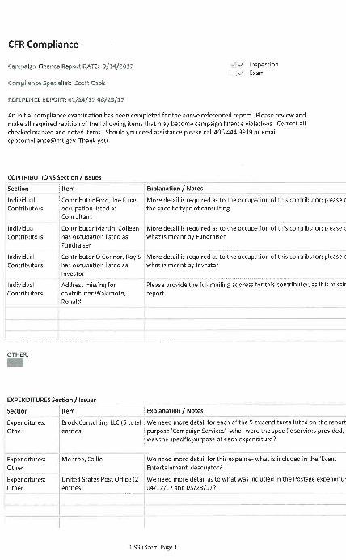
Inspection Reports & Exams
After a report is filed, copp will provide guidance with cursory inspection reports
Make revisions as requested
Exam at end of campaign
It is the candidate’s ultimate responsibility to report correctly and completely!

Slide 64
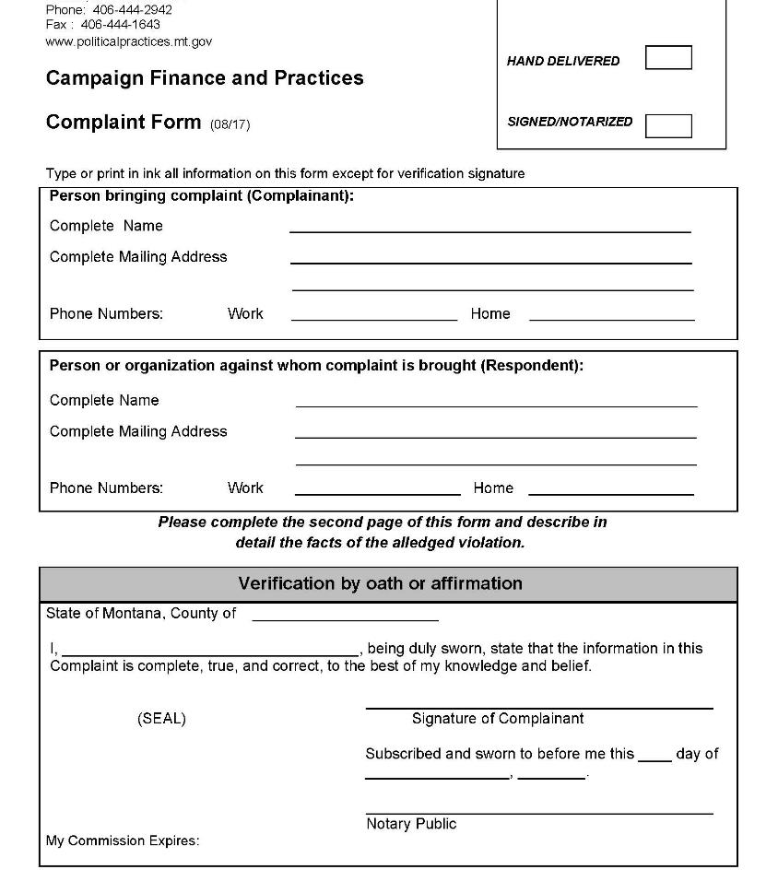
Order of Noncompliance and Formal Complaints
The Commissioner may file an order of noncompliance compelling compliance with all reporting laws/rules
Failure to file reports as required or fully/accurately disclose contributions received and expenditures made may lead to a formal campaign finance complaint being filed against a candidate
Complaint process is public- anyone can file a complaint

Slide 65
Questions? Contact us!
https://politicalpractices.mt.gov/
Email: cpphelp@mt.gov and cppcompliance@mt.gov
Phone: (406) 444-2942
Facebook/Twitter: @MontanaCOPP
Additional resources:
the candidate and treasurer guide to navigating cers
Accounting and reporting manual for candidates and campaign treasurers (green book)
General reporting and disclosure tips

