Slide 1
Candidate Campaign Finance Training
May 2021
Office of Political Practices
Jeff Mangan
Notes:
Welcome!
All material will be posted to the COPP’s website and shared out on our Twitter and Facebook accounts.

Slide 2
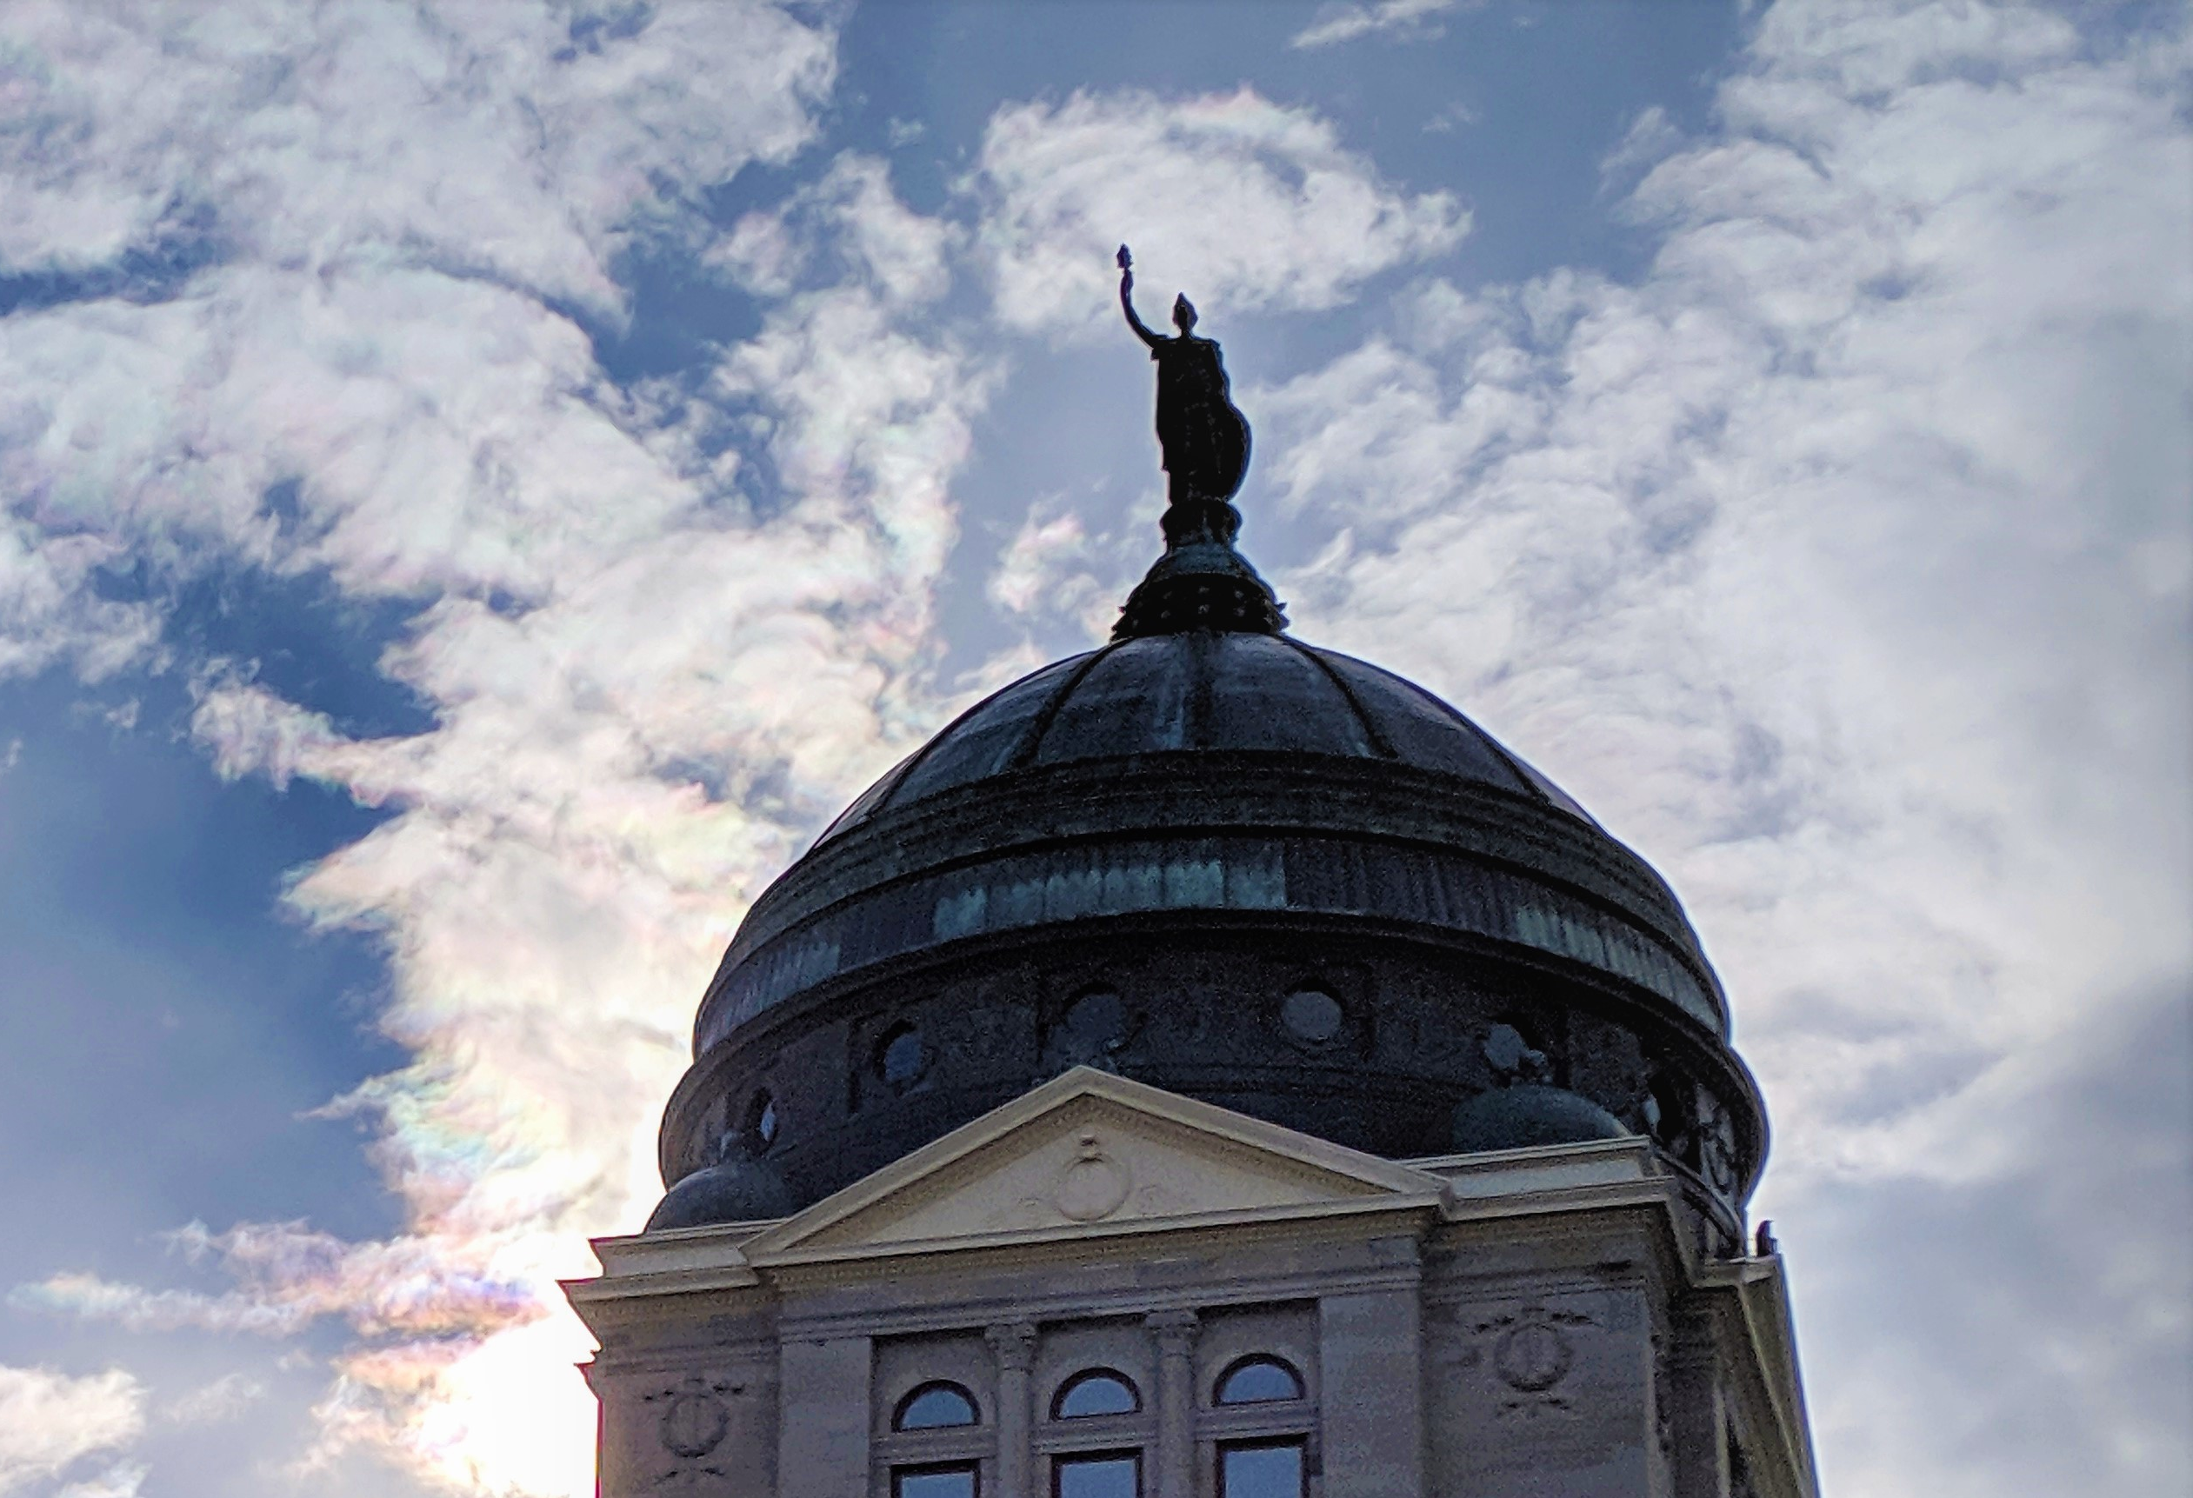
Training outline
Candidate’s Legal Requirements
Candidate Forms & Reporting Dates
Campaign Finance (Contributions, Expenditures, & Debts)
Campaign Finance Review Process
Tips
Resources
Questions
cpphelp@mt.gov

Slide 3
Legal Requirements of Candidates
It is the candidate’s responsibility and obligation to understand and comply with all Montana campaign finance laws. While COPP staff is available to provide information and support to all candidates and treasurers, it is the candidate who is ultimately responsible for ensuring the campaign complies with all campaign finance laws.
Candidates should familiarize themselves with Montana’s campaign finance reporting laws, specifically Montana Code Annotated (MCA) Title 13, Chapter 37 (available here), as well as the Administrative Rules of Montana (ARM) Rule Chapter 44.11 (available here). In addition to this training, the COPP’s website contains several educational resources that candidates should know and reference.
Notes:
Jeff’s slide

Slide 4
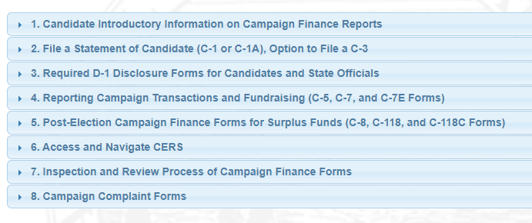
Candidate Forms
http://politicalpractices.mt.gov/forms
Notes:
TRANSITION: Dates that must be on your radar

Slide 5
Statement of Candidate C1/C1A
File a statement of candidate form with the COPP within 5 days of:
  Soliciting or receiving a contribution
  Making an expenditure
  Filing as a candidate for elected office
Local (City/County/School) select ‘B’ or ‘C’ box
  B box candidates do not expect to raise or spend over $500, exempt from Finance reporting
    Must file finance reports if exceed $500 AND amend C1A form to C box
  C box candidates plan to exceed $500
  Must still designate a campaign treasurer and bank
  Please always include an email address

Slide 6
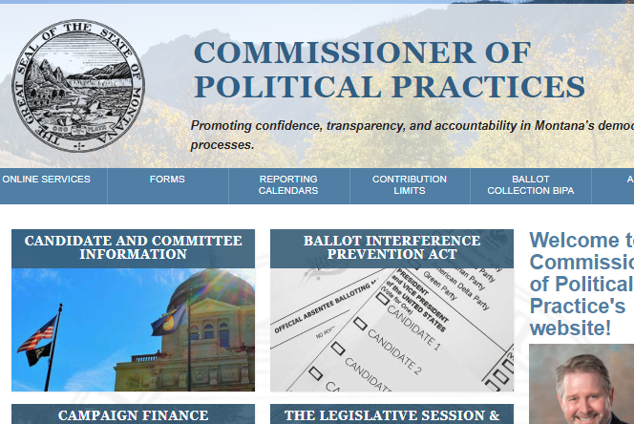
Candidate Reporting Dates
Reporting Dates for Odd Year candidates (Municipal)
Reporting Dates for Even Year Candidates
Off election Year reporting dates from a previous election
Off election Year reporting dates for a future election
Notes:
Things to note:
Starting November 2019, all candidates—regardless of type (statewide, district, city, etc.) will follow the same C-5 reporting calendar
*TIP: Make yourself relevant reminders for report due dates!
TRANSTION: Next, we will cover what must be disclosed in C-5 CFS

Slide 7
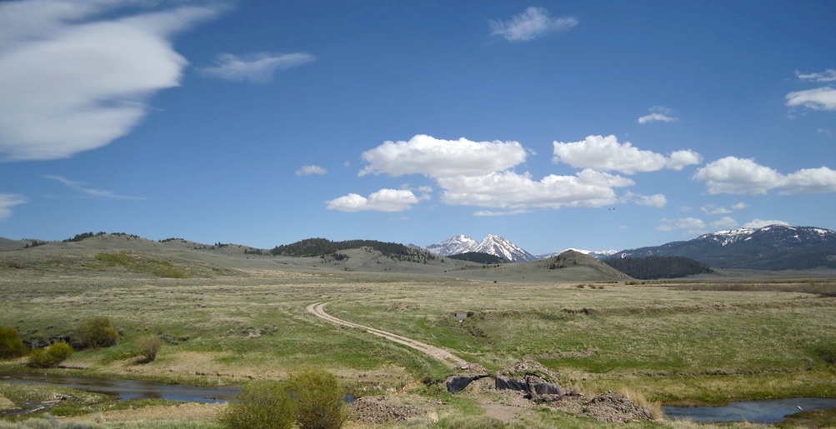
Campaign Finance
All candidates have a role in promoting confidence, transparency, and accountability in Montana’s elections. This occurs, in part, through campaign finance reporting of:
  Contributions,
  Expenditures, and
  Debts.
Notes:
JEFF: cover campaign finance’s role in transparency, public confidence
TRANSITION: Next, we are going to dig into contributions that you may receive, and what you will need to report.

Slide 8

Campaign Finance: Contributions
By law (13-1-101(9), MCA), a contribution is defined as a “…distribution of money or anything of value to support or oppose a candidate or ballot issue.”
If an individual (including the candidate or candidate’s family!), committee, or other entity provides a campaign with money or goods or services of value for free or at a reduced rate in an effort to support your candidacy, that is a contribution.
Notes:
First bullet: Monetary in nature. Or non-monetary
TRANSITION: And the amount of a contribution you can receive is defined by MT’s contribution limits….

Slide 9
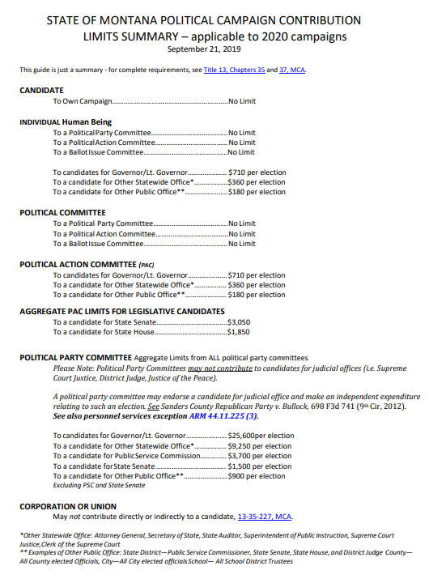
Contribution Limits
Campaign finance limits apply to EACH election (primary and general) if you have a primary opponent.
Fundraising for the primary and general election must be completely separate. This means that contributions must be designated as either a primary or general election contribution.
Aggregate contribution limits apply for political party committees.
Notes:
Contribution limits apply PER ELECTION.
If there is not a contested primary, there is only ONE election to which contribution limits apply.
TRANSITION: when you need a quick reference to your contribution limits….

Slide 10
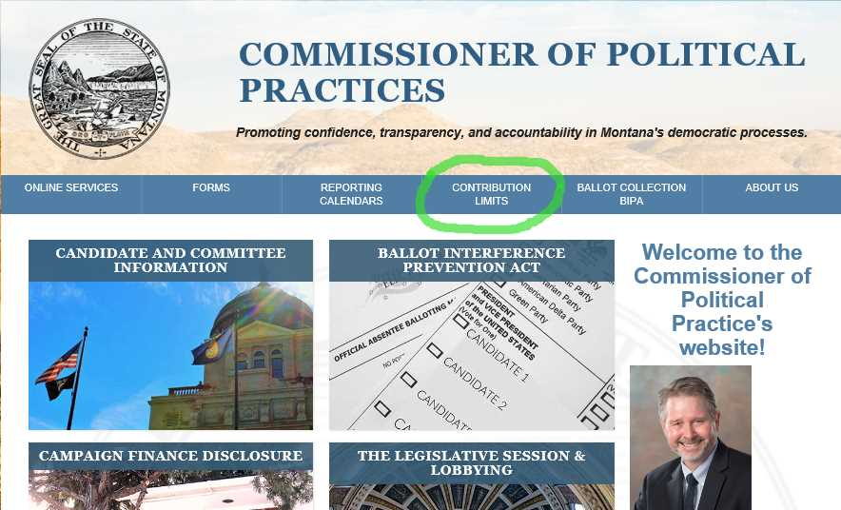
Contribution Limits: Know Your Limits
http://politicalpractices.mt.gov/contributionlimits
Notes:
TRANSITION: Contribution limits, and that they apply per election, let’s dig into the types of contributions

Slide 11

Contributions: Types of Contributions
Candidate’s contributions to self
Contributions from individuals
  Contributions less than $35
Fundraisers
Contributions from committees
Refunds, rebates
Loans
Notes:
Refunds and rebates, and loans: Aren’t going into detail on these. Focusing on the first four types

Slide 12

Candidate Self Contributions
There is no limit on the amount a candidate may contribute to his or her own campaign.
A contribution means that the candidate will not be reimbursed.

Slide 13

Contributions: Individual
Amount of contribution ($35 threshold)
Identifying contributor information:
  Name
  Address
  Employer and occupation
  Monetary or in-kind (All in-kind contributions must include a description of the specific items or services received by the campaign)
Monetary or in-kind
**Anonymous contributions are illegal**
Notes:
Occupation: Be specific! “Consultant” is not specific enough. Marketing consultant, political strategy consultant, etc. should be used.
Volunteering time
**Anonymous contributions are illegal**
TIP: CERS tracks cumulative contribution amounts (useful tool)
Transitions: Fundraisers

Slide 14

Contributions: Fundraisers
Each individual fundraising event held by the campaign must be reported separately as its own event.
Details to include:
  Event description (Raffle, pass-the-hat, banquet, silent auction, etc.)
  Approximate number of attendees
  Number of tickets sold (if applicable)
  Total amount raised
Notes:
TIP: CERS tracks cumulative contribution amounts (useful tool)

Slide 15
Contributions: Fundraisers (continued)
Contributions of less than $35 from a fundraiser can be reported as a lump sum.
Any individual contribution of $35 or more must be reported under the “Contributions” tab’s “Individual” option).
** Anonymous contributions are illegal. The source of contributions from a fundraiser must always be recorded, even if an individual’s fundraising-related contribution does not meet the $35 reporting threshold. This also ensures that if an individual contributes $35 in the aggregate or more, their contributions can be correctly reported.**
Notes:
Occupation: Be specific! “Consultant” is not specific enough. Marketing consultant, political strategy consultant, etc. should be used.
**Anonymous contributions are illegal**
CERS tracks cumulative contribution amounts (useful tool)
Transition → Committee contributions

Slide 16

Contributions: Committee
Details to disclose:
  Date
  Committee type (Political party, independent, incidental, etc.)
  Monetary or in-kind (All in-kind contributions must include a description of the specific items or services received by the campaign)
Contribution limits apply
Notes:
Date= date contribution received
*Campaign must deposit all contributions within five days
$900 contribution limit for political party committees to candidates
TRANSITION: → Expenditures

Slide 17

Campaign Finance: Expenditures
Remember: all money spent by a campaign must be able to be known in an audit.
Expense details to disclose:
  Whether the expense went to support the primary or general campaign
  Date the payment was made
  Description of expense – Ad agency, contractor, etc. must be itemized
Notes:
Audit: This means that expenses must be paid by check, debit card, wire transfer or other electronic means that clearly identify the person who received payment from a campaign account and the payment date.
Strongly advised not to use petty cash (Also, petty cash is no longer allowed after October 1, 2019)
Examples:
1000 yard signs with “J Coffee for Commish,” 50 “vote for Jane” t-shirts, gasoline for drive from billings to Helena (218 miles) for xyz convention
TRANSITION→ Now that we’ve covered individual contributions, fundraisers, and committee contributions, we will look at reporting campaign expenses.

Slide 18

Expenditures: Attribution for Paid Communications
Any paid communication in support or opposition to a candidate must include “Paid for by” information on the material.
The attribution must clearly identify the name and mailing address of the entity that paid for the communication.
  For example: Paid for by Potter for City Council, 12 Cupboard Lane, Helena, MT 59601
Material too small? File the material with the COPP!
Notes:
Attribution Information Guide: http://politicalpractices.mt.gov/Education-and-Resources/Attribution-Information
If your campaign material is too small to include an attribution, you must file a copy of the material or item with the Commissioner of Political Practices with attribution at the time the material is published.
If you fail to attribute an election communication, the person financing the communication must notify the Commissioner of Political Practices within two days of discovering the error and make every reasonable effort to bring the material into compliance. No materials should be disseminated that are not in compliance. Any communications must be pulled until they have been corrected.

Slide 19

Campaign Finance: Debts
Debts and loans must be recorded with the same level of disclosure as expenditures.
The debt must occur within the campaign finance report reporting period. If the exact amount is unknown, the estimated amount must be reported
Payments to campaign debt must also be reported.
Notes:
Same level of detail

Slide 20
Campaign Finance Review Process
First, candidate files a campaign finance report
  COPP reviews this campaign finance report and sends the candidate an Inspection Report identifying any issues that require additional attention or detail
  Candidate files other reports
  COPP follows up with Inspection Reports
  Candidate closes their campaign
  COPP follows up with an Exam
  Candidate addresses all outstanding issues.
Notes:
Inspection Report:
The Inspection Report identifies any issues that the candidate or committee must address in their campaign finance reports in order to comply with Montana law. For example, an Inspection Report will alert candidates to items that require additional detail or information, items that may not be reported in the correct place or manner, or other potential issues. Click here to see a sample Inspection Report.
Information about the COPP’s inspection and exam process: http://politicalpractices.mt.gov/Education-and-Resources/Inspection-and-Exam-Process

Slide 21
Candidate’s responsibility
It is the candidate’s responsibility and obligation to understand and comply with all Montana campaign finance laws. While COPP staff is available to provide information and support to all candidates and treasurers, again, it is the candidate who is responsible for ensuring the campaign complies with all campaign finance requirements.
Candidates should familiarize themselves with Montana’s campaign finance reporting laws, specifically Montana Code Annotated (MCA)Title 13, Chapter 37 (available here), as well as the Administrative Rules of Montana (ARM) Rule Chapter 44.11 (available here). In addition to this training, the COPP’s website contains several educational resources that candidates should know and reference.

Slide 22
Tips
Add campaign finance reporting periods and date/s to your calendar with reminders (Google calendar, cell phone, kitchen calendar, whatever helps remind you)
Need more space in CERS? Add as an attachment within CERS
Don’t wait until the last minute to complete your campaign finance reports! Update reports regularly throughout the reporting period
Read your inspection reports and make corrections as directed
For tips and report reminders, follow the COPP on Facebook and Twitter!
Contact the COPP for support and with questions!
Notes:
To include an addendum in a campaign finance report, first, note in the "purpose" description "See addendum." Then, email cppcompliance@mt.gov, explain that you have an addendum to add for your C-5 report for the dates of xx/xx/xxxx-xx/xx/xxxx, and include the missing information in the email text. The COPP will upload the addendum's information to the CERS database.

Slide 23
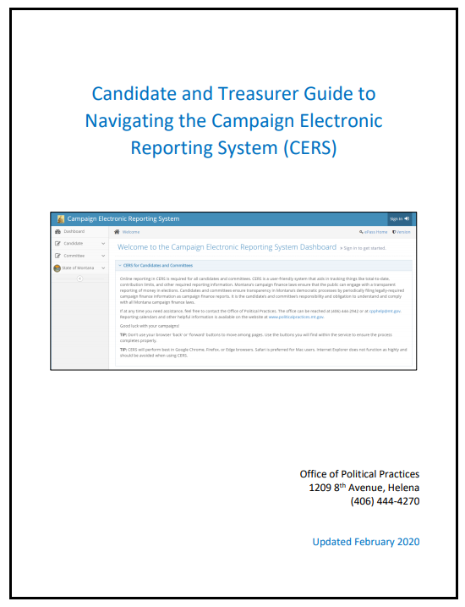
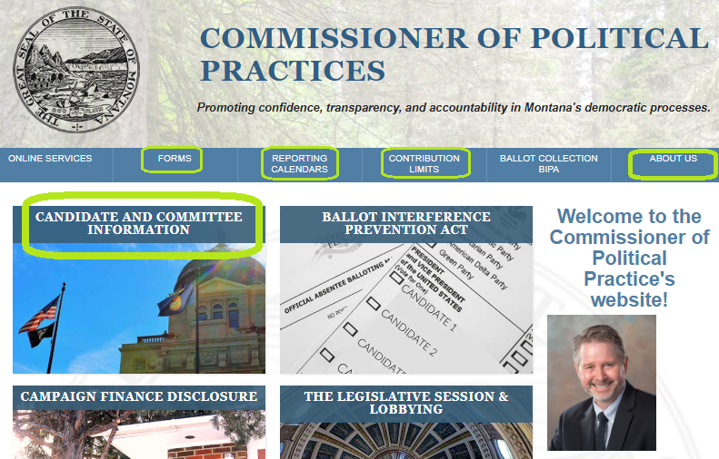
RESOURCES
Notes:
Candidate and committee information page has info about:
Campaign finance laws
Campaign finance process (accounting and reporting manual for candidates and treasurers, guide to registering, inspection and exam process, FAQ for closing out campaign account post-primary and post-general)
Guide to all campaign finance forms
Guides! Guide to required “Paid for by” info and how to report paid communications, yard signs
Complaint info, etc.

Slide 24
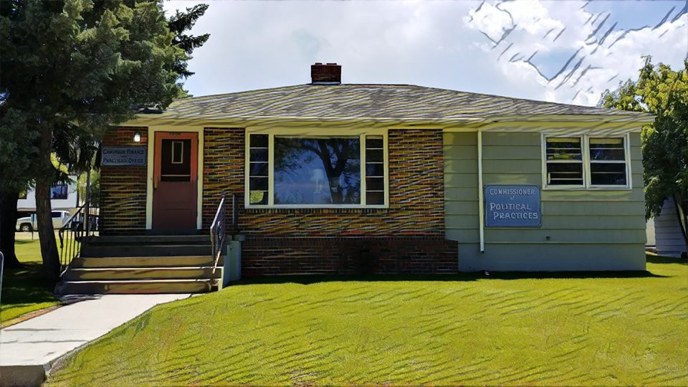


Questions? Contact the COPP!
1209 8th Avenue (Helena)
(406) 444-2942
cppcompliance@mt.gov
@MontanaCOPP
@MontanaCOPP

