Slide 1
COMMITTEE finance Reporting
Montana Commissioner of Political Practices
cpphelp@mt.gov / @MontanaCOPP

Slide 2
School districts- election activity
Employees of a school district may not support or oppose the passage of a ballot issue while on the job or at the place of employment, 13-35-226(4), MCA
Similarly, elected officers and public employees of a school district may not utilize public time, resources, etc. to support or oppose a ballot issue, 2-2-121(3)(a)
Employees may individually, on own time, support or oppose a ballot issue
The school district itself may engage in activities “properly incidental to another activity required or authorized by law”, including “determining the impacts of passage or failure of a ballot issue” on its operations and the “dissemination of information” to electors, 2-2-121(3)(b)

Slide 3
School district committees- report to COPP!
School districts that make expenditure/s of $250.00 or more related to a ballot issue are to register with copp
Does not include costs associated with administering the actual election
Applies only to Certain school districts - A List of all districts required to register is available via opi’s website
certain School candidates are also required to register with Copp!!

Slide 4
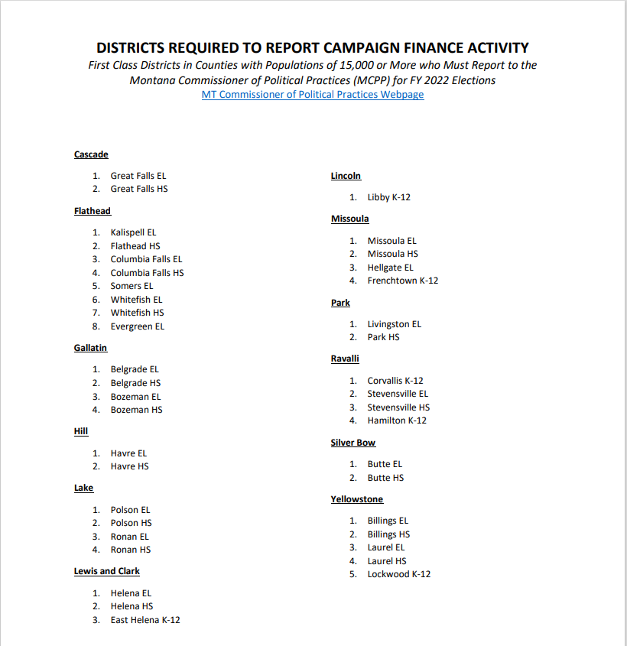

Slide 5
File electronically, using CERs
All reporting will be done electronically, using the campaign electronic reporting system (cers)
Access Cers from the copp’s website, https://politicalpractices.mt.gov/
click the ‘access cers’ icon

Slide 6
Registering a new committee
Step 1: from the cers dashboard, click ‘access my account’

Slide 7
Registering a new committee
Step 2: sign in via okta
Sign in using a username (email address) and password

Slide 8
Registering a new committee
Step 3: navigate to the ‘committees’ tab, then click ‘add new registration’
Cers will prompt you to search for committee before a new one can be created
After search, click ‘add new registration’ to register a new committee

Slide 9
Registering a new committee
Step 4: complete the committee registration by entering in all information
Committee type will be ‘incidental- local government’
When complete, click ‘save’
To file, certify, then click ‘submit and file’

Slide 10
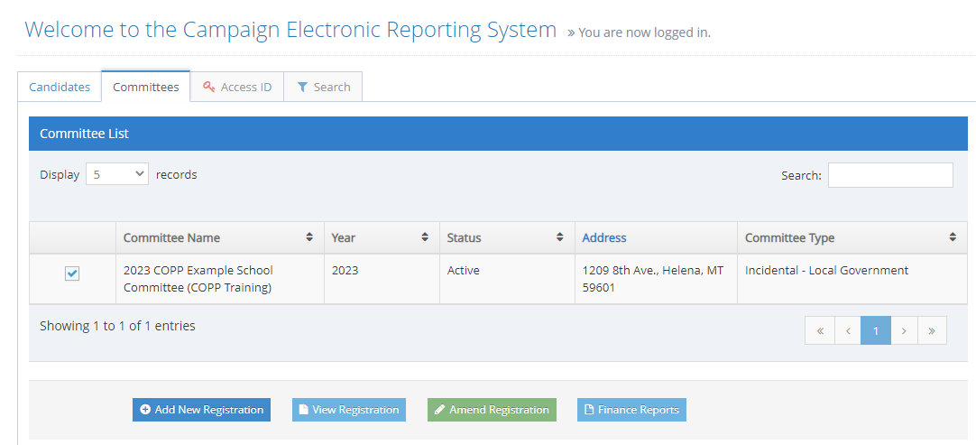
Update the C2 Within 5 days of change
Treasurer revision, address, email or phone number change, etc.

Slide 11
REVIEW
Questions about filing a committee registration in cers?
Notes:
REVIEW CONTRIBUTIONS online real time on CERS

Slide 12
Reporting dates
For 2023 school election: finance reports due March 3, March 28, April 20, and May 22, 2023
Full reporting calendar available on the reporting calendars section of copp website

Slide 13
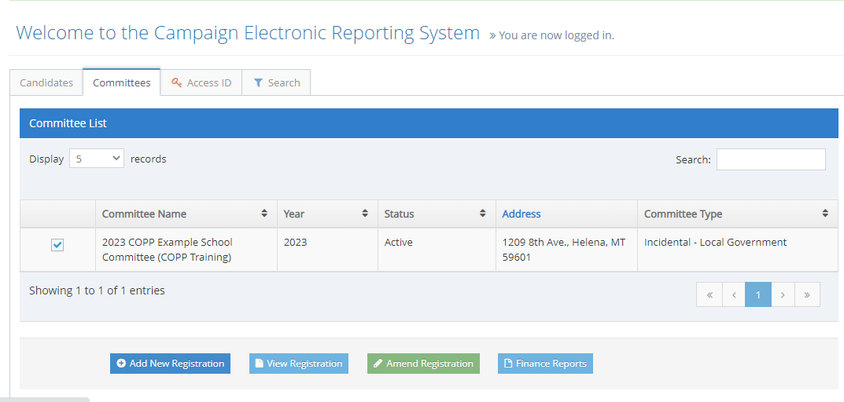
Filing a committee finance report
Step 1: from the committee list, click ‘finance reports’
Doing so will take you to the committee’s finance report list

Slide 14
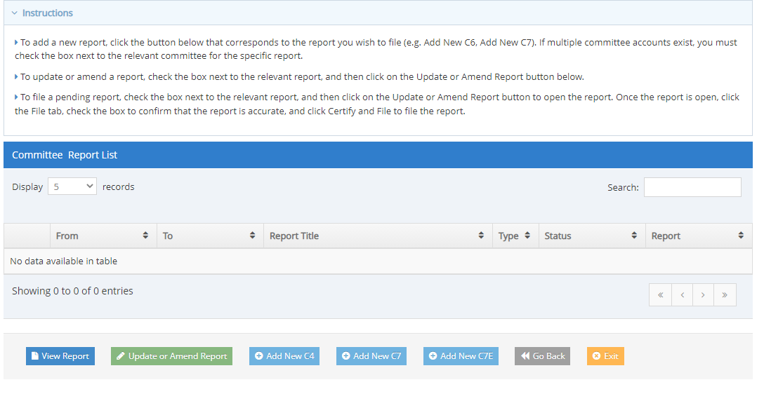
Filing a committee finance report
Step 2: from the committee report list, click ‘add new c4’
Form c4 is the incidental-local government committee finance report
Best practice is to update regularly as you receive contributions and make expenditures
Data is not public until a report is filed

Slide 15
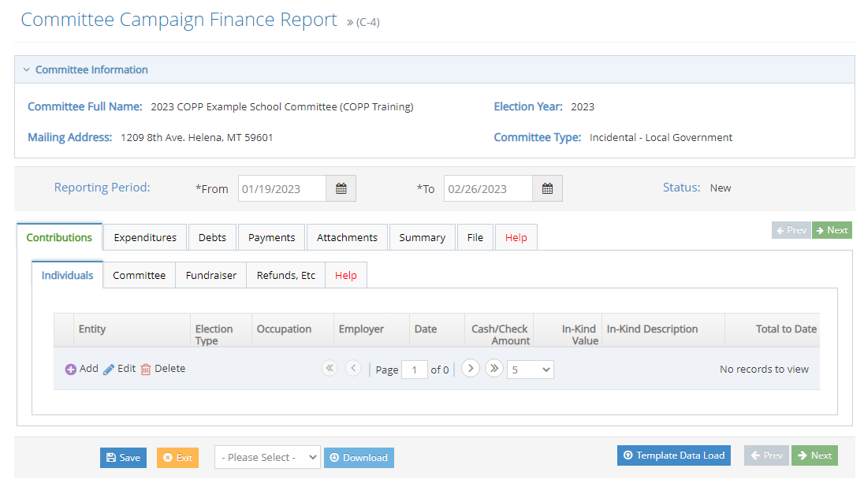
Filing a committee finance report
Step 3: enter all expenditure/debt information into the report
Report expenditures using the ‘expenditures’ tab
Report debts owed using the ‘debts’ tab
Report payments made on debts using the ‘payments’ tab

Slide 16
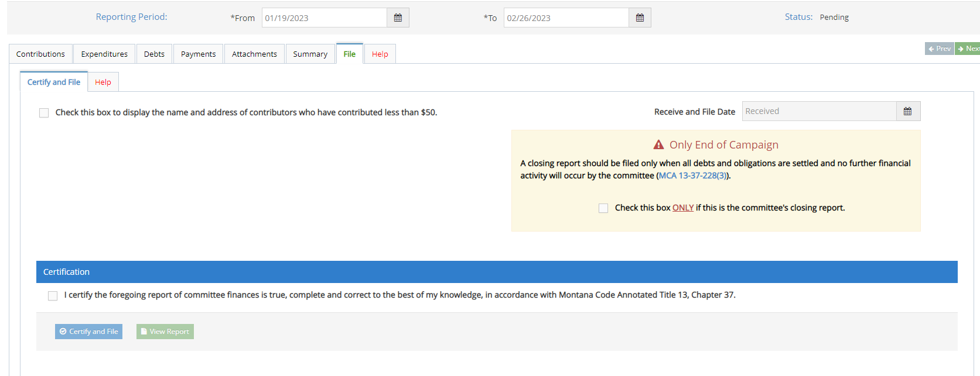
Filing a committee finance report
Step 4: when complete, file the report!
To file, navigate to the ‘file’ tab, follow the instructions to certify and file

Slide 17
REVIEW
Questions about filing a committee finance report in cers?
Notes:
REVIEW CONTRIBUTIONS online real time on CERS

Slide 18
Tips For Reporting expenditures!

Slide 19
reporting expenditures
Report all expenditures using the “expenditures” tab
Examples: fliers educating registered voters about what ballot issue a proposes; radio ad detailing impacts on district a should ballot issue b pass/fail

Slide 20
Adding an expenditure
Under expenditures tab, navigate to the ‘expenditures’ subtab
Click ‘add’ to add a new expenditure

Slide 21
Adding an expenditure
Use ‘Row Details’ to manually enter
‘entity search’ allows you to search for entity
When all required information has been entered, hit ‘submit’
Save after every entry!

Slide 22
Reporting expenditures
Expenditures must be reported on the finance report covering the period where the expenditure was made
Expenditures must be supported by a “written agreement, invoice, billing statement, or similar documentation appropriate to the transaction”, 44.11.502, ARM

Slide 23
Reporting expenditures
All expenditures must be reported with the full name and address of the vendor, date of the expenditure, purpose of the expenditure, and full amount of the expenditure

Slide 24
Reporting expenditures
“Reports of expenditures made to a consultant, advertising agency, polling firm, or other person that performs services for or on behalf of a candidate, political committee, or joint fundraising committee must be itemized and described in sufficient detail to disclose the specific services performed by the entity to which payment or reimbursement was made”, 13-37-229(2)(b), MCA

Slide 25
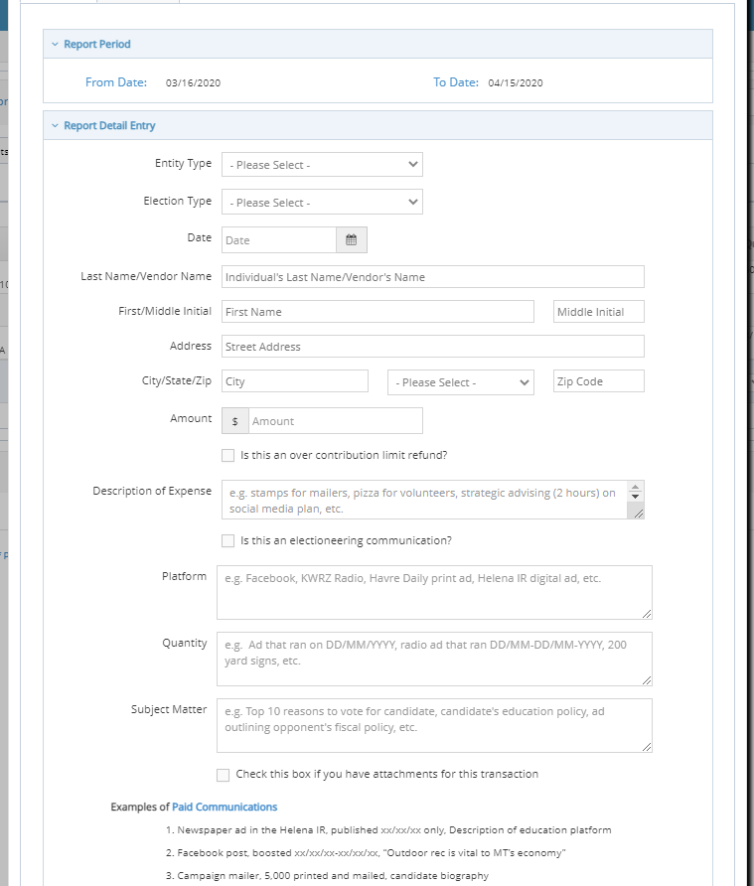
Add an attachment
Can add a receipt, statement, or invoice as an attachment when reporting an expenditure
Notes:
Treat paid social media ads, boosts, promotions, sponsored, etc. as any other expenditure – Detail and describe expenditure in the ‘Purpose’ field

Slide 26
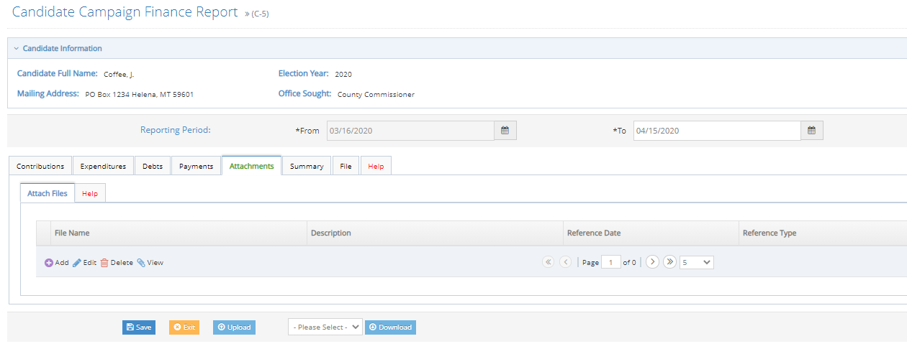
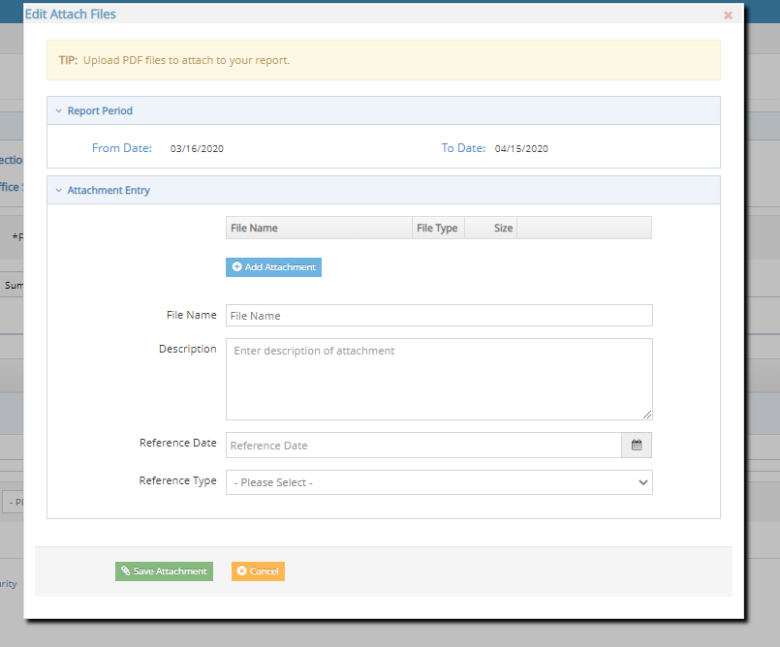
Add an attachment
To add an attachment, use the ‘attachments’ tab
Notes:
Treat paid social media ads, boosts, promotions, sponsored, etc. as any other expenditure – Detail and describe expenditure in the ‘Purpose’ field

Slide 27
Social Media Expenditure Reporting
As with any other expenditure, report all paid social media activities
If contracted out or part of an ad Agency service, must be itemized
Notes:
In describing a paid social media expenditure, you may use date range

Slide 28
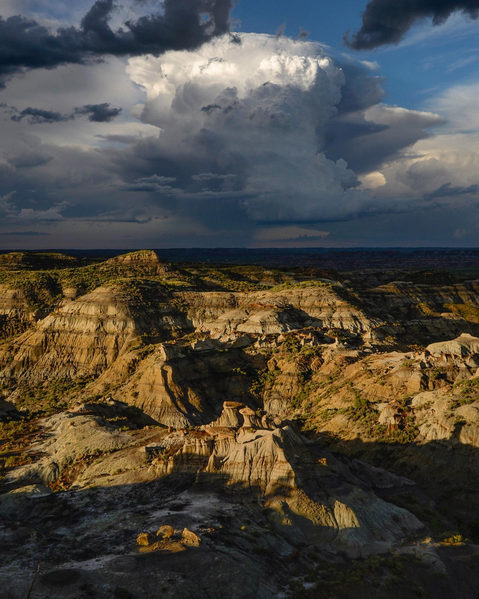
Reporting – debts and payments
Notes:
Petty cash is allowed; recommended to avoid petty cash, use debit card, etc. Track all expenditures

Slide 29
Adding a debt
Debt= obligation owed but not yet paid by committee
Under debts tab, navigate to the ‘debt/loan payments’ subtab
Click ‘add’ to add a new debt

Slide 30
Adding a debt
Use ‘Row Details’ to manually enter
‘entity search’ allows you to search for entity
When all required information has been entered, hit ‘submit’
Save after every entry!

Slide 31
debts
Report debts with same level of detail as expenditures
Debts owed by the committee must be reported at the time the obligation is incurred
Common reporting error – waiting for invoice to report
If you do not know amount, estimate (you can amend if necessary)

Slide 32
Adding a payment
Payment= payment provided on a previously reported debt or loan
Under payments tab, navigate to the ‘payments’ subtab
Select a debt or loan to make a payment on, then Click ‘add payment’ to add a new payment

Slide 33
Adding a payment
Enter the date of the payment in the ‘date field’
Enter the amount of the payment in the ‘paid amount’ field
When date and payment amount information has been entered, hit ‘submit’
Save after every entry!

Slide 34
payments
Payments on outstanding debts or loans owed by the committee are reported using the ‘payments’ tab
Obligations do not have to be paid off in full all at once- can pay off incrementally

Slide 35
REVIEW
Questions about reporting expenditures, debts, or payments?
Notes:
REVIEW CONTRIBUTIONS online real time on CERS

Slide 36
Reminder: Certify and file the report!
From the ‘file’ tab, navigate to the ‘certify and file’ subtab
Certify the report, then click ‘certify and file’
A report is not filed until it has been certified and filed!

Slide 37
Additional items and information
Attribution
Inspection reports and exams
Orders of noncompliance and formal campaign complaints

Slide 38
attribution
ALL paid campaign materials require a ‘paid for by’ attribution message, 13-35-225, MCA.
Includes any paid social media activity!
Must include the statement ‘paid for by’ with the name of the committee, committee address, and name of committee treasurer/other listed officer
example: paid for by Montanans for coffee, po box 1, Helena, mt 59601. J coffee, treasurer

Slide 39
Attribution webpage
https://politicalpractices.mt.gov/Education-and-Resources/Attribution-Information
Notes:
TIP! Make sure you have the latest version—check the date in the bottom right of the image

Slide 40
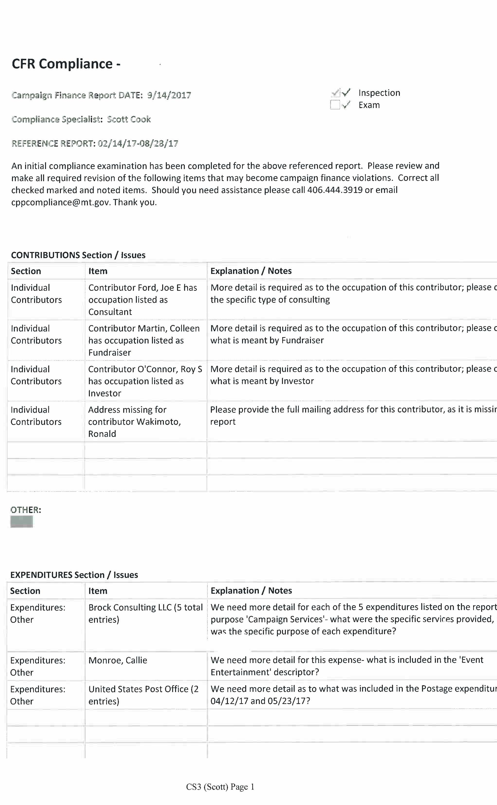
Inspection Reports & Exams
After a report is filed, copp will provide guidance via cursory inspection reports
Make revisions as requested
Exam at end of election cycle
It is the committee’s ultimate responsibility to report correctly and completely

Slide 41
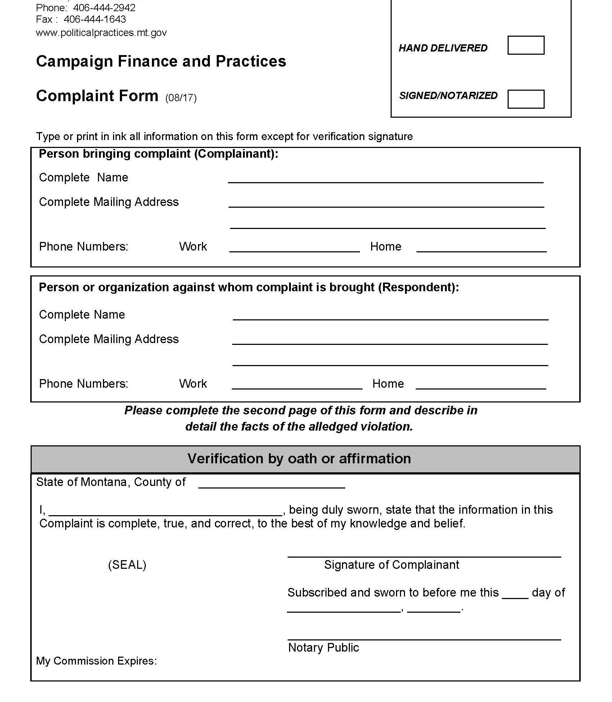
Order of Noncompliance and Formal Complaints
The Commissioner may file an order of noncompliance compelling compliance with all reporting laws/rules
Failure to file reports as required or fully/accurately disclose contributions received and/or expenditures made may lead to a formal campaign finance complaint being filed against a committee
Complaint process is public- anyone can file a complaint

Slide 42
Questions? Contact us!
https://politicalpractices.mt.gov/
Email: cpphelp@mt.gov and cppcompliance@mt.gov
Phone: (406) 444-2942
Facebook/Twitter: @MontanaCOPP
Additional resources:
The Committee and treasurer guide to navigating cers
Accounting and reporting manual for political committees (pink book)
Photo credit:
Visit montana (visitmt.com and facebook.com/visitmontana)

