Slide 1
City Candidate Campaign Finance Training
July 18, 2019 Office of Political Practices
Jeff Mangan
Kym Trujillo
Katie Beall

Slide 2
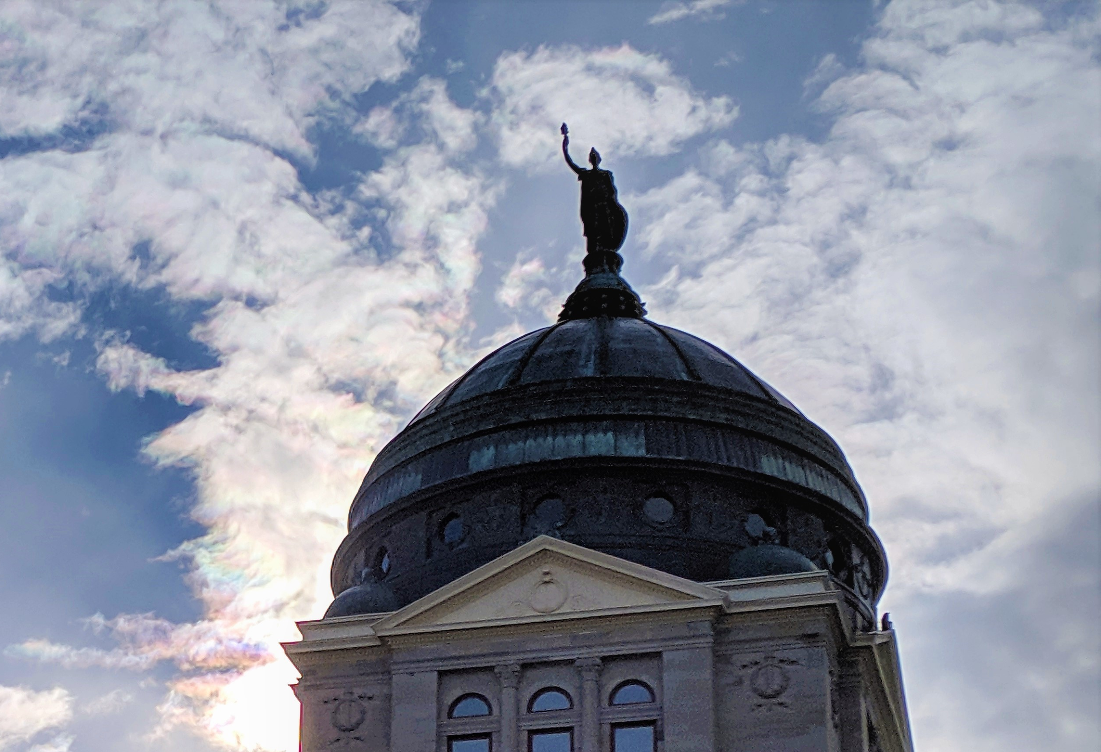
Training outline
Candidate’s Legal Requirements
City Candidate Forms & Reporting Dates
Campaign Finance (Contributions, Expenditures, & Debts)
Campaign Finance Review Process
Tips
Resources
Questions
cpphelp@mt.gov

Slide 3
Legal Requirements of Candidates
It is the candidate’s responsibility and obligation to understand and comply with all Montana campaign finance laws. While COPP staff is available to provide information and support to all candidates and treasurers, again, it is the candidate who is responsible for ensuring the campaign complies with all campaign finance requirements.
Candidates should familiarize themselves with Montana’s campaign finance reporting laws, specifically Montana Code Annotated (MCA)Title 13, Chapter 37 (available here), as well as the Administrative Rules of Montana (ARM) Rule Chapter 44.11 (available here). In addition to this training, the COPP’s website contains several educational resources that candidates should know and reference.

Slide 4
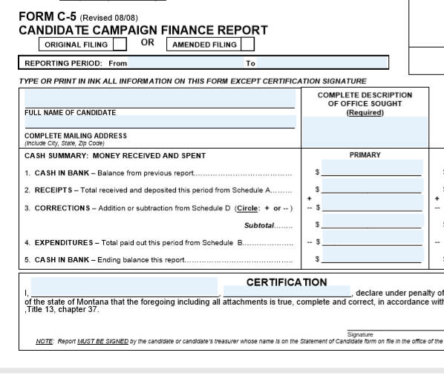
City Candidate Forms
C-1A: Statement of Candidate
C-5: Candidate Campaign Finance Report
C-7: Notice of Pre-Election Contributions
Must be filed if a city candidate receives a contribution of $100 or more from a single source between the 17th day before an election and the date of the election.
Notes:
C1-A
On a C-1A form, candidates must designate themselves either a 'B' box candidate (less than $500 will be cumulatively raised and spent), or a 'C' box candidate (more than $500 raised/spent). ‘C’ box candidates must file campaign finance reports with our office.
C-1A Statement of Candidate form must be updated WITHIN 5 days if any information changes (e.g. email address, contact info, banking info, treasurer info, etc.)
C-7s:
Primary election: August 24-September 10
October 15-November 5: C-7s due (for general)

Slide 5
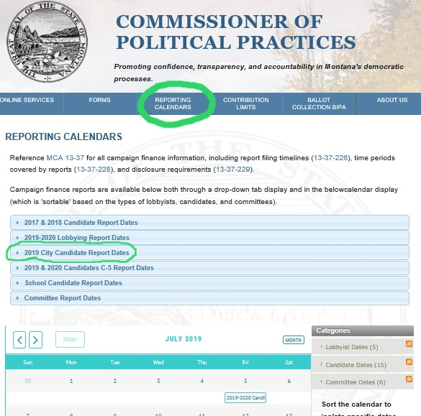
City Candidate Forms: 2019 Reporting Dates
August 6: C-5 Due
August 24-September 10: C-7s due (for primary)
August 29: C-5 Due
August 31-September 10: Fair NoticePeriod (for primary)
Primary Election: September 10
September 30: C-5 Due
October 1: C-5 Due
October 15-November 5: C-7s due (for general)
October 20: C-5 due
October 26-November 5: Fair Notice Period (for general)
General Election: November 5
November 20: C-5 Due
March 10: Report due if campaign still open
September 10: Report due if campaign still open
Notes:
Starting November 2019, all candidates—regardless of type (statewide, district, city, etc.) will follow the same C-5 reporting calendar
*TIP: Make yourself relevant reminders for report due dates!

Slide 6
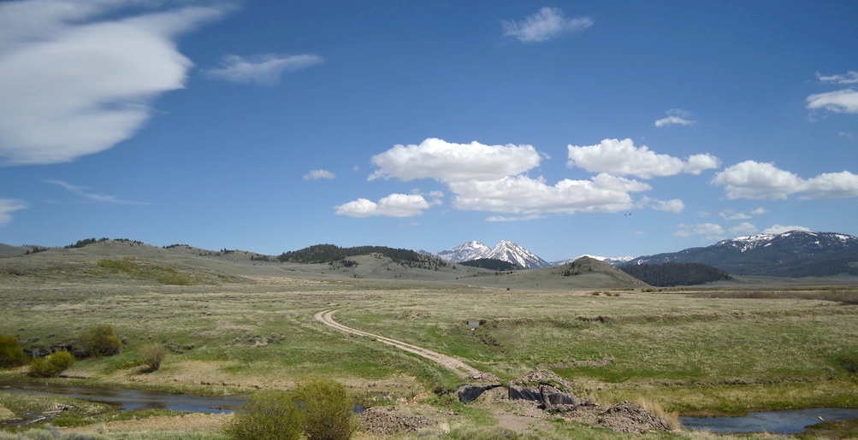
Campaign Finance
All candidates have a role in promoting confidence, transparency, and accountability in Montana’s elections. This occurs, in part, through campaign finance reporting of:
Contributions,
Expenditures, and
Debts.
Notes:
Montana campaign finance law protects the public’s right to know who is paying to finance elections.
Every Montanan must be able to look at any election expense and be able to know who financed the material in addition to telling it apart from other, similar activities.
As a candidate, you are required to disclose campaign-finance related details to ensure transparency. You ensure Montanans elections remain transparent by reporting contributions and expenditures with enough detail so they are both distinguishable and are easily attributed back to their source.

Slide 7

Campaign Finance: Contributions
By law (13-1-101(9), MCA), a contribution is defined as a “…distribution of money or anything of value to support or oppose a candidate or ballot issue.”
If an individual, committee, or other entity provides a campaign with money or goods or services of value for free or at a reduced rate in an effort to support your candidacy, that is a contribution.

Slide 8
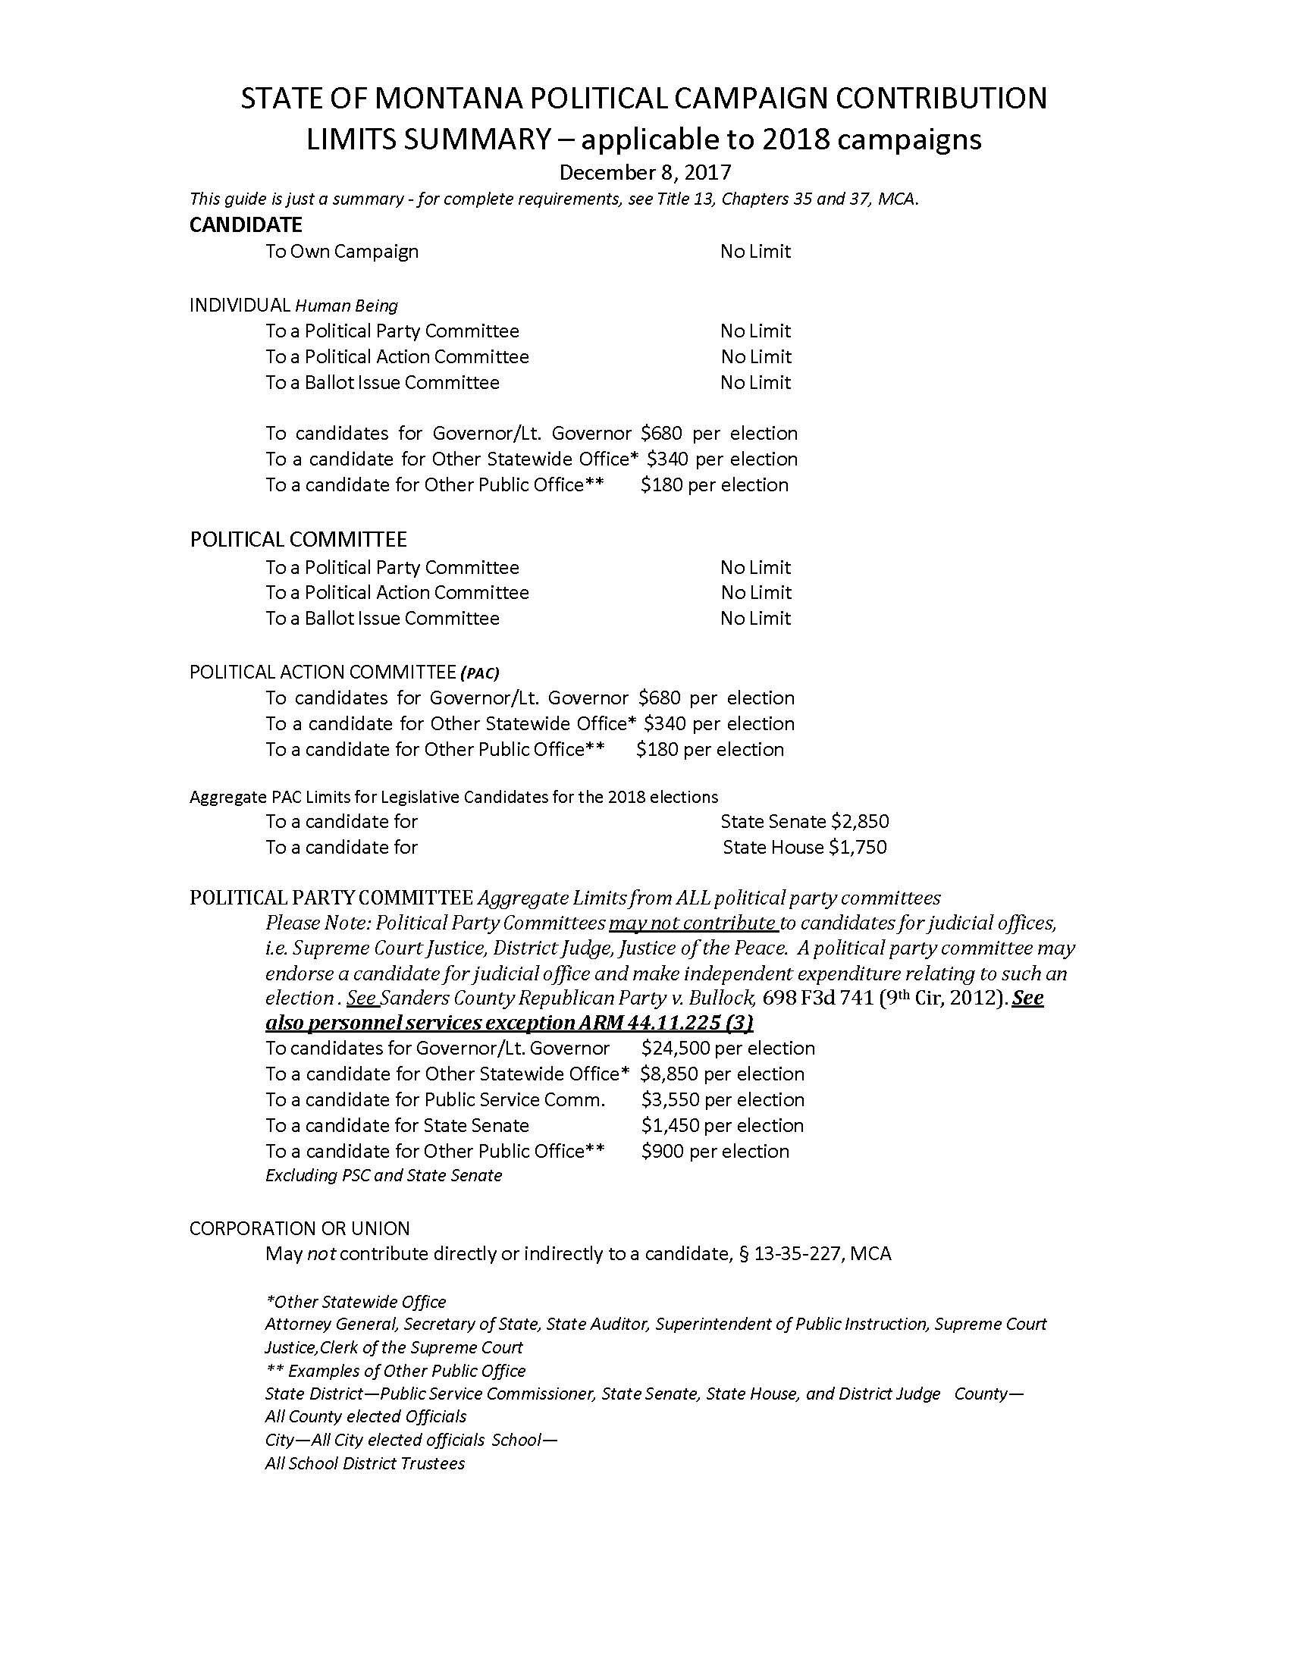
Contribution Limits
Campaign finance limits apply to EACH election (primary and general) if you have a primary opponent.
Fundraising for the primary and general election must be completely separate. This means that contributions must be designated as either a primary or general election contribution.
Aggregate contribution limits apply for political party committees.
Notes:
Contribution limits apply PER ELECTION.
If there is not a contested primary, there is only ONE election to which contribution limits apply.
$180 contribution limit for individuals to city candidates
$900 contribution limit for political party committees to candidates

Slide 9
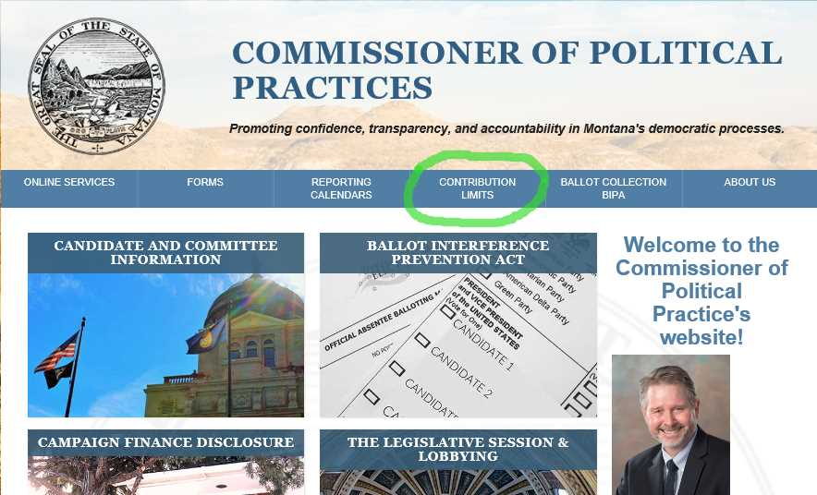
Contribution Limits: Know Your Limits
http://politicalpractices.mt.gov/contributionlimits
Notes:
$180 contribution limit for individuals to city candidates
$900 contribution limit for political party committees to candidates

Slide 10

Contributions: Types of Contributions
Candidate’s contributions to self
Contributions from individuals
Contributions less than $35
Fundraisers
Contributions from committees
Refunds, rebates
Loans

Slide 11

Candidate Self Contributions
There is no limit on the amount a candidate may contribute to his or her own campaign.
A contribution means that the candidate will not be reimbursed.

Slide 12

Contributions: Individual
Amount of contribution ($35 threshold)
Identifying contributor information:
Name
Address
Employer and occupation
Monetary or in-kind (All in-kind contributions must include a description of the specific items or services received by the campaign)
Monetary or in-kind
**Anonymous contributions are illegal**
Notes:
Occupation: Be specific! “Consultant” is not specific enough. Marketing consultant, political strategy consultant, etc. should be used.
Volunteering time
**Anonymous contributions are illegal**
TIP: CERS tracks cumulative contribution amounts (useful tool)

Slide 13

Contributions: Fundraisers
Each individual fundraising event held by the campaign must be reported separately as its own event.
Details to include:
Event description (Raffle, pass-the-hat, banquet, silent auction, etc.)
Approximate number of attendees
Number of tickets sold (if applicable)
Total amount raised
Notes:
TIP: CERS tracks cumulative contribution amounts (useful tool)

Slide 14
Contributions: Fundraisers (continued)
Contributions of less than $35 from a fundraiser can be reported as a lump sum.
Any individual contribution of $35 or more must be reported under the “Contributions” tab’s “Individual” option).
** Anonymous contributions are illegal. The source of contributions from a fundraiser must always be recorded, even if an individual’s fundraising-related contribution does not meet the $35 reporting threshold. This also ensures that if an individual contributes $35 in the aggregate or more, their contributions can be correctly reported.**
Notes:
Occupation: Be specific! “Consultant” is not specific enough. Marketing consultant, political strategy consultant, etc. should be used.
**Anonymous contributions are illegal**
CERS tracks cumulative contribution amounts (useful tool)

Slide 15

Contributions: Committee
Details to disclose:
Date
Committee type (Political party, independent, incidental, etc.)
Monetary or in-kind (All in-kind contributions must include a description of the specific items or services received by the campaign)
Contribution limits apply
Notes:
Date= date contribution received
*Campaign must deposit all contributions within five days
$900 contribution limit for political party committees to candidates

Slide 16

Campaign Finance: Expenditures
Remember: all money spent by a campaign must be able to be known in an audit.
Expense details to disclose:
Whether the expense went to support the primary or general campaign
Date the payment was made
Description of expense: this must be able to distinguish one expense from another
Notes:
Audit: This means that expenses must be paid by check, debit card, wire transfer or other electronic means that clearly identify the person who received payment from a campaign account and the payment date.
Strongly advised not to use petty cash (Also, petty cash is no longer allowed after October 1, 2019)
Examples:
1000 yard signs with “J Coffee for Commish,” 50 “vote for Jane” t-shirts, gasoline for drive from billings to Helena (218 miles) for xyz convention

Slide 17
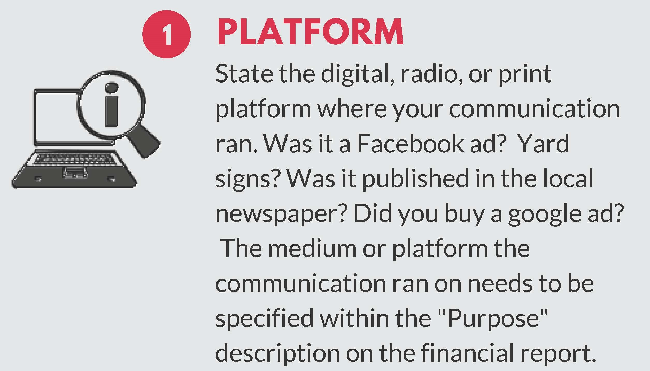
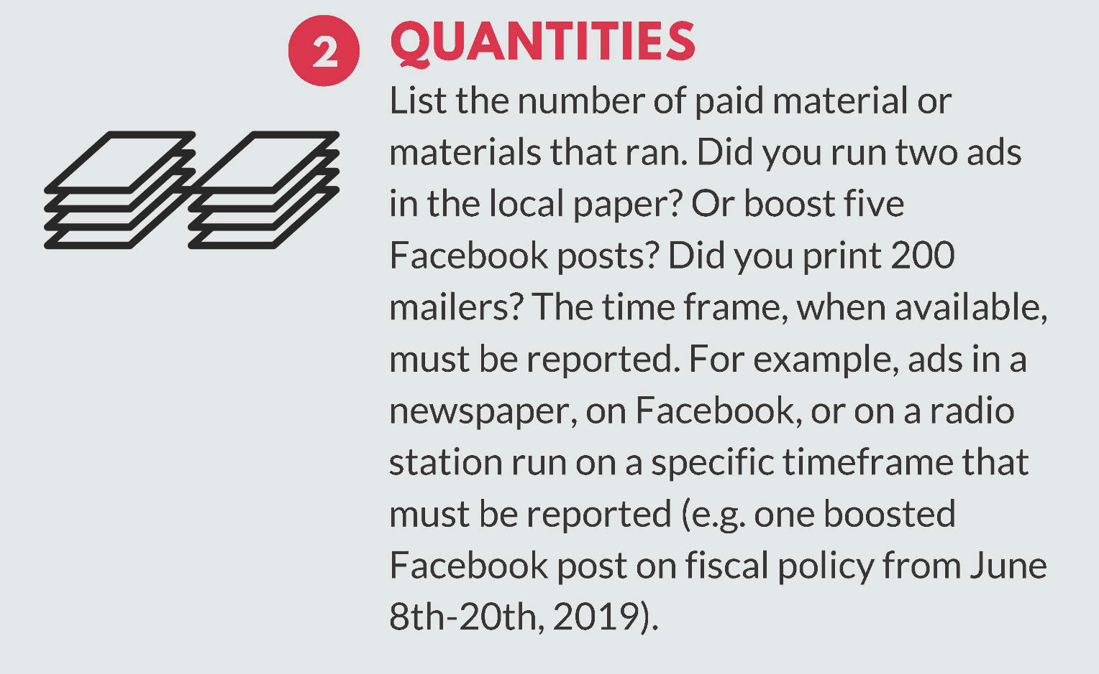
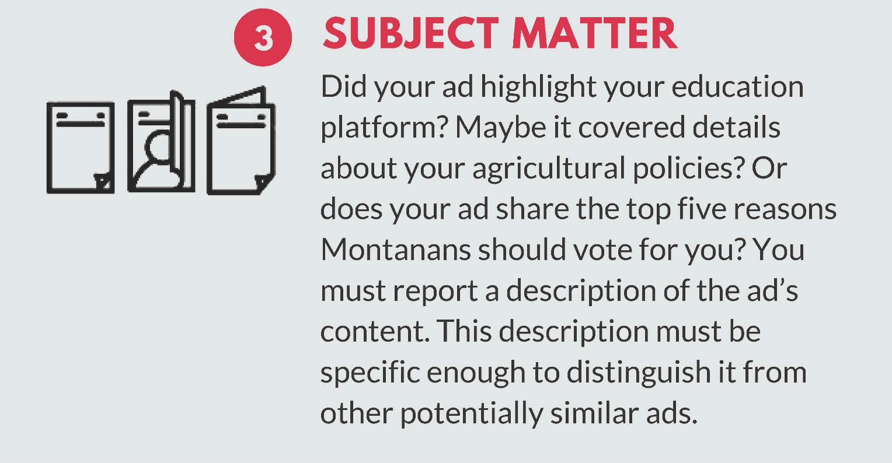
Expenditures: Reporting Paid Communications Details (Purpose)
Facebook ad, “Education is important” post- ran from xx/xx to xx/xx/xx
CEBL radio ads
- Ad 1: Ran xx/xx/xxxx, 30-second ad discussing candidate's community roots
- Ad 2: Ran xx/xx/xxxx, 30-second ad discussing candidate's qualifications
- Ad 3: Ran xx/xx/xxxx, 30-second ad discussing candidate's agricultural policy
Notes:
Guide to paid communications: http://politicalpractices.mt.gov/Home/Campaign-Finance-and-Practices/Expenditures-Paid-Communications

Slide 18

Expenditures: Attribution for Paid Communications
Any paid communication in support or opposition to a candidate must include “Paid for by” information on the material.
The attribution must clearly identify the name and mailing address of the entity that paid for the communication. (e.g. Paid for by Potter for City Council, 12 Cupboard Lane, Helena, MT)
Material too small? File the material with the COPP!
Notes:
Attribution Information Guide: http://politicalpractices.mt.gov/Education-and-Resources/Attribution-Information
If your campaign material is too small to include an attribution, you must file a copy of the material or item with the Commissioner of Political Practices with attribution at the time the material is published.
If you fail to attribute an election communication, the person financing the communication must notify the Commissioner of Political Practices within two days of discovering the error and make every reasonable effort to bring the material into compliance. No materials should be disseminated that are not in compliance. Any communications must be pulled until they have been corrected.

Slide 19

Campaign Finance: Debts
Debts and loans must be recorded with the same level of disclosure as expenditures.
The debt must occur within the campaign finance report reporting period. If the exact amount is unknown, the estimated amount must be reported
Payments to campaign debt must also be reported.
Notes:
Same level of reporting detail is required for debts as with expenditures

Slide 20
Campaign Finance Review Process
Candidate files a campaign finance report
→ COPP reviews all campaign finance reports and sends the candidate an Inspection Report identifying any issues that require additional attention or detail
→ Candidate files other reports
→ COPP follows up with Inspection Reports
→ Candidate closes their campaign
→ COPP follows up with an Exam
→ Candidate addresses all outstanding issues.
Notes:
Inspection Report:
The Inspection Report identifies any issues that the candidate or committee must address in their campaign finance reports in order to comply with Montana law. For example, an Inspection Report will alert candidates to items that require additional detail or information, items that may not be reported in the correct place or manner, or other potential issues. Click here to see a sample Inspection Report.
Information about the COPP’s inspection and exam process: http://politicalpractices.mt.gov/Education-and-Resources/Inspection-and-Exam-Process

Slide 21
Candidate’s responsibility
It is the candidate’s responsibility and obligation to understand and comply with all Montana campaign finance laws. While COPP staff is available to provide information and support to all candidates and treasurers, again, it is the candidate who is responsible for ensuring the campaign complies with all campaign finance requirements.
Candidates should familiarize themselves with Montana’s campaign finance reporting laws, specifically Montana Code Annotated (MCA)Title 13, Chapter 37 (available here), as well as the Administrative Rules of Montana (ARM) Rule Chapter 44.11 (available here). In addition to this training, the COPP’s website contains several educational resources that candidates should know and reference.

Slide 22
Tips
Add campaign finance reporting periods and date/s to your calendar with reminders (Google calendar, cell phone, kitchen calendar, whatever helps remind you)
Need more space in CERS? Filing an addendum (cppcompliance@mt.gov)
1) Update your reports regularly throughout the period, and 2) file after the end of the period and before the deadline (do not wait for last minute to file)
Read your inspection reports and make corrections as directed
For tips and report reminders, follow the COPP on Facebook and Twitter!
Contact the COPP for support and with questions!
Notes:
To include an addendum in a campaign finance report, first, note in the "purpose" description "See addendum." Then, email cppcompliance@mt.gov, explain that you have an addendum to add for your C-5 report for the dates of xx/xx/xxxx-xx/xx/xxxx, and include the missing information in the email text. The COPP will upload the addendum's information to the CERS database.

Slide 23
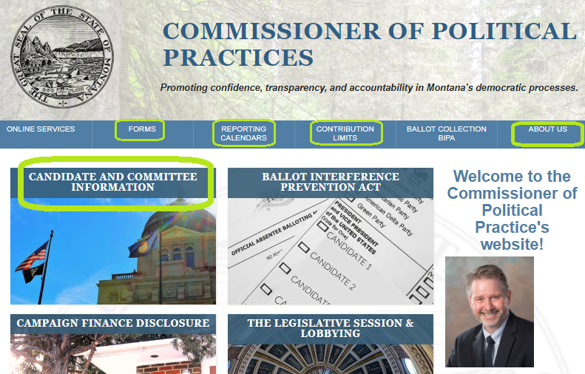
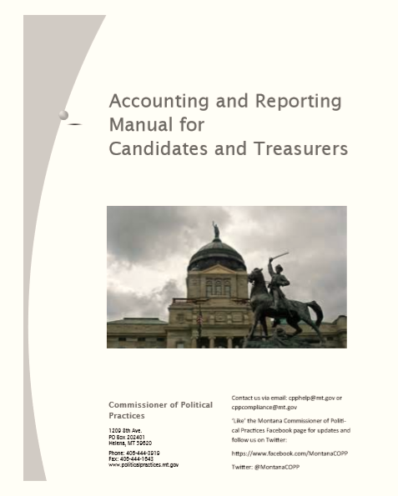
RESOURCES
Notes:
Candidate and committee information page has info about:
FAQ for 2019 city candidates
Campaign finance laws
Campaign finance process (accounting and reporting manual for candidates and treasurers, guide to registering, inspection and exam process, FAQ for closing out campaign account post-primary and post-general)
Guide to all campaign finance forms
Guides! Guide to required “Paid for by” info and how to report paid communications, yard signs
Complaint info, etc.

Slide 24
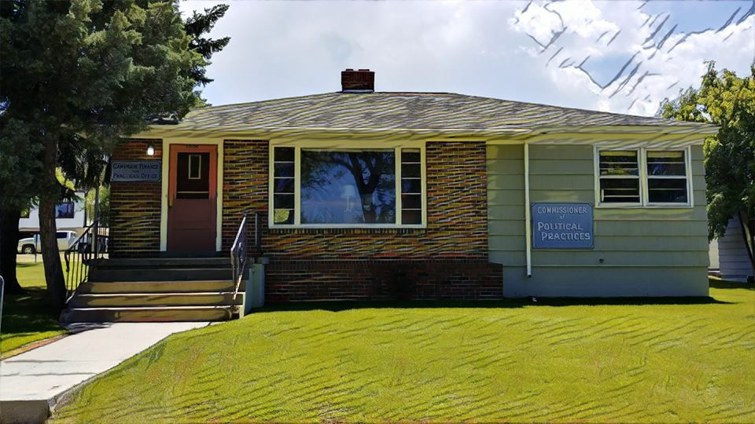


Questions? You’ve got support!
1209 8th Avenue (Helena)
(406) 444-2942
cppcompliance@mt.gov
@MontanaCOPP
@MontanaCOPP

