Slide 1
Lobbying and Montana’s 2025 legislative session

Slide 2
What is lobbying?
Lobbying is defined as “the practice of promoting or opposing the introduction or enactment of legislation before the legislature or legislators” and “the practice of promoting or opposing official action of any legislator or the legislature”, 5-7-102(11)(a), MCA.
Examples of lobbying would include testifying in support of Senate Bill 123 in a state Senate committee hearing, or speaking with individual legislators encouraging them to oppose House Bill 456.
Lobbying does not include actions performed “by a public official, an elected local official, an elected federal official, or an elected tribal official while acting in an official governmental capacity”, 5-7-102(11)(b), MCA.

Slide 3
What is a lobbyist?
A lobbyist is “a person who engages in the practice of lobbying”, 5-7-102(12)(a), MCA.
Any lobbyist paid $3,000.00 or more to lobby must register with COPP by filing form L-1, the lobbyist license application

Slide 4
Do I need to register as a lobbyist?
Yes, if:
You are a lobbyist paid $3,000.00 or more to lobby
No, if:
You are an individual lobbying solely on your own behalf, or
You are a lobbyist but total compensation received is less than $3,000.00

Slide 5
What is a principal?
A principal is a person or entity who employs a lobbyist, 5-7-102(15), MCA
This includes businesses, associations, government agencies and others who pay lobbyists to work on their behalf
Any principal who pays $3,000.00 or more for lobbying must register with COPP by filing form L-2 (the Principal Authorization Statement) or L-3 (the Principal Registration Application)

Slide 6
Do I need to register with copp as a Principal?
Yes, if:
No, if:
You are a principal who provides payment of $3,000.00 or more to individual lobbyist/s
You are a principal making payments to lobbyist/s, but at a total less than $3,000.00

Slide 7
How do I Decide what form I need to register as a principal?
To decide what Principal Authorization Statement to fill out, ask:
Have you paid or intend to pay more than $3,000.00 to an individual lobbyist to lobby on your behalf? If so, you would file a Principal Authorization Statement, form L-2
Have you paid or intend to pay more than $3,000.00 to lobbyists to lobby on your behalf, but no individual will individually be paid that amount? If so, you would file a Principal Registration Application, form L-3.
Notes:
What if a principal plans to 1) pay three individuals over $2,650* or more each to three lobbyists?, or 2) plans to pay one individual lobbyist over $2,650* and will also pay a group of 3 lobbyists less than $2,650 COMBINED for 2021?
The lobbyists will each file an L-1 and the principal will file an L-2 for each lobbyist
The lobbyist paid over $2,650 will file an L-1. The 3 lobbyists being paid less than $2,650 do not need to file form L-1. The principal would only need to file an L-2 for the lobbyist being paid $2,650 or more; however the payments to the 3 paid less than $2,650 need to be included on the L-5

Slide 8
How do I register with copp?
Step 1
The lobbyist submits form L-1, the lobbyist license application
A lobbyist must register within five business days after entering into an oral or written agreement to receive payment of $3,000.00 or more for the purposes of lobbying
Step 2
The lobbyist or principal pays the $150.00 lobbyist registration fee
This can be paid by either the principal on behalf of the lobbyist or the lobbyist personally
Step 3
The principal submits form L-2, the Principal Authorization Statement, or form L-3, the Principal Registration Application
Notes:
Step1: The L-1 application lists the name of the principal(s) the lobbyist will be working for, as well as the subject(s) or issue(s) the applicant will be lobbying for or against.

Slide 9
Quick lobbying form review
L1: Lobbyist License Application
Filed by the lobbyist if paid $3,000.00 or more to lobby
L2: Principal Authorization Statement
Filed by the principal if providing payment of $3,000.00 or more to a single lobbyist
L3: Principal Registration Application
Filed by the principal if payment/s made to lobbyist/s total $3,000.00 or more, but no individual lobbyist is paid that amount

Slide 10
Principals to file finance reports with Copp!
All registered Principals are required to periodically report lobbying payments made to support or assist lobbying activity via form L-5!
The L-5 report tracks:
Payments or other monetary compensation provided to the lobbyist/s authorized to lobby on the Principal’s behalf. This includes lobbyists who are paid but will not meet the threshold amount and are not required to register with the COPP;
The cost of support staff, administrative fees (office rent, internet, etc.), or travel expenses paid to support or assist lobbying activity;
Equipment, advertising, or supplies or social expenditures used to support or assist lobbying activity; and
Expenditures associated with entertainment events (dinners, banquets, socials, etc.) meant to lobby individual members of the legislature.

Slide 11
Principals to file finance reports with Copp!
Report Due Dates:
February 15, 2025- MANDATORY Initial Report (covers January 2025)
March 15, 2025- February monthly report (covers February of 2025)- required only if monthly spending in February totals $5,000.00 or more
April 15, 2025- March monthly report (covers March of 2025)- required only if monthly spending in March totals $5,000.00 or more
30 days after session- MANDATORY Post-session report, due 30 days after the session adjourns (covers the end date of last report filed through the end of the session)
Complete calendar is available on the COPP’s website

Slide 12
Principals to file finance reports with Copp!
Reports must be received by 5:00 p.m. on the due date. Reports can be filed:
Electronically, using the Principal and Lobbyist Online Reporting System
Hard copy (paper)- via mail (P.O. Box 202401, Helena, MT 59620-2401), fax (406-444-1643), or hand-delivery (1209 8th Avenue, Helena, MT)
There is a $50/day penalty for late reports!

Slide 13
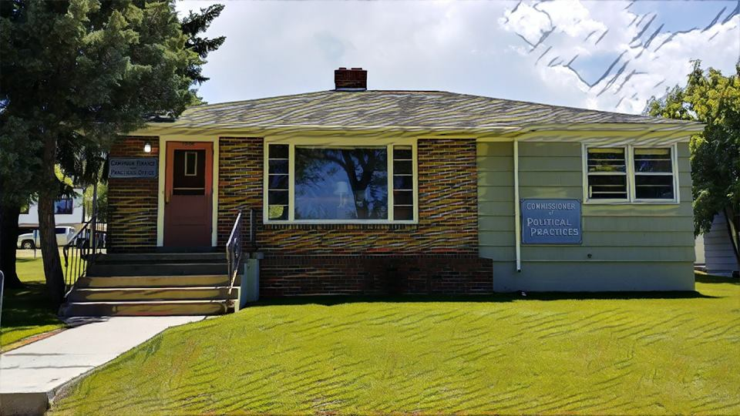
Questions?
Call us! 444-2942
Email us at cppcompliance@mt.gov or cpphelp@mt.gov
Check out our website, specifically the Legislative Session and Lobbying page: https://politicalpractices.mt.gov/Home/Legislative-Session-and-Lobbying/

